Slide 1
Chapter 14 Strings, Characters and Regular Expressions

Slide 2
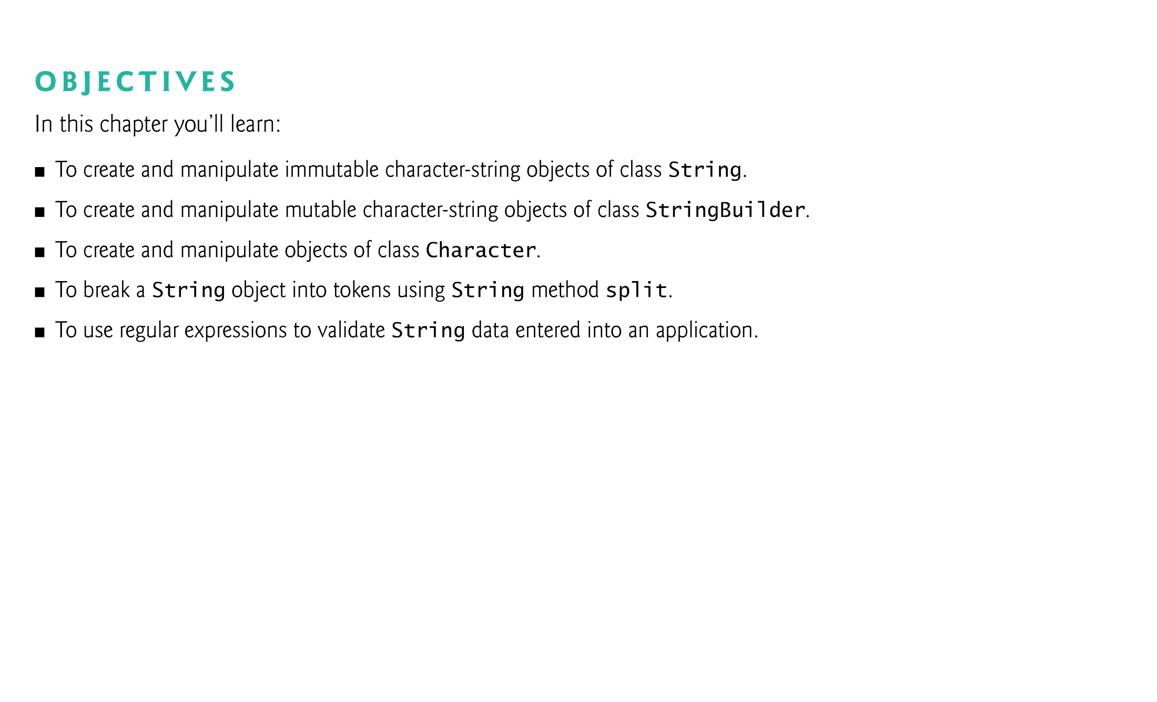

Slide 3
14.1 Introduction
This chapter discusses class String, class StringBuilder and class Character from the java.lang package.
These classes provide the foundation for string and character manipulation in Java.
The chapter also discusses regular expressions that provide applications with the capability to validate input.

Slide 4
14.2 Fundamentals of Characters and Strings
A program may contain character literals.
An integer value represented as a character in single quotes.
The value of a character literal is the integer value of the character in the Unicode character set.
String literals (字符串字面值 stored in memory as String objects) are written as a sequence of characters in double quotation marks.

Slide 5
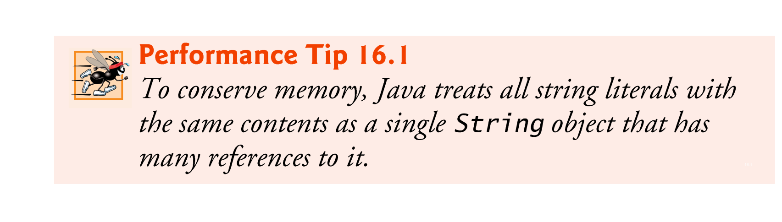
String s1 = “string literals”;
String s2 = “string literals”;
if(s1==s2) ….

Slide 6
14.3 Class String
Class String is used to represent strings in Java.
The next several subsections cover many of class String’s capabilities.

Slide 7
14.3.1 String Constructors
four constructors
No-argument constructor
One-argument constructor
A String object
One-argument constructor
A char array
Three-argument constructor
A char array
An integer specifies the starting position
An integer specifies the number of characters to access

Slide 8
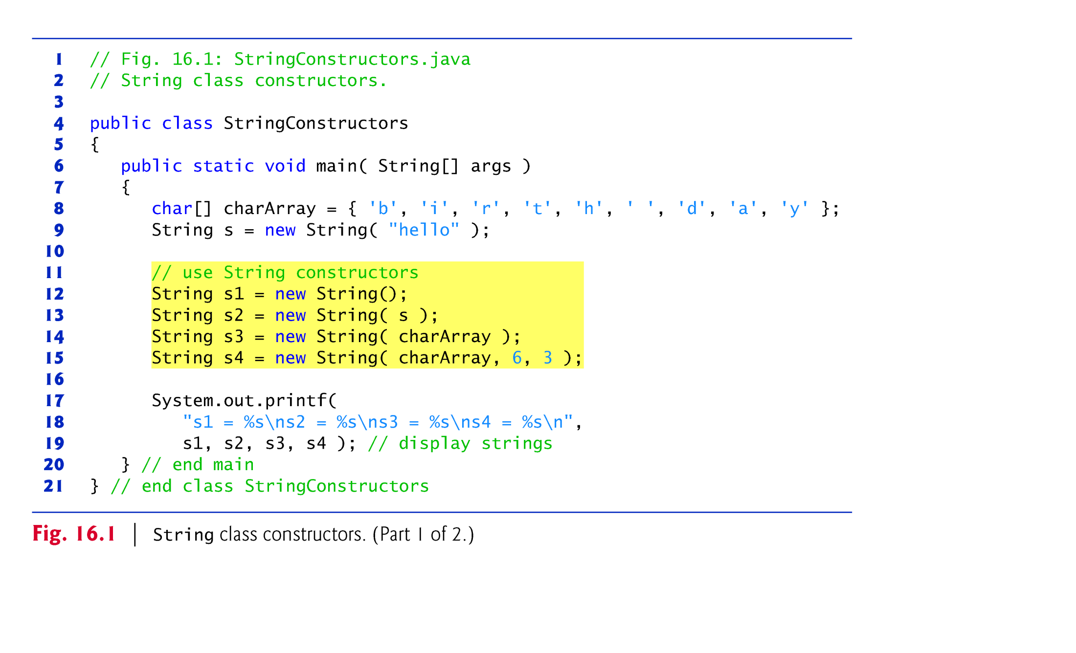

Slide 9
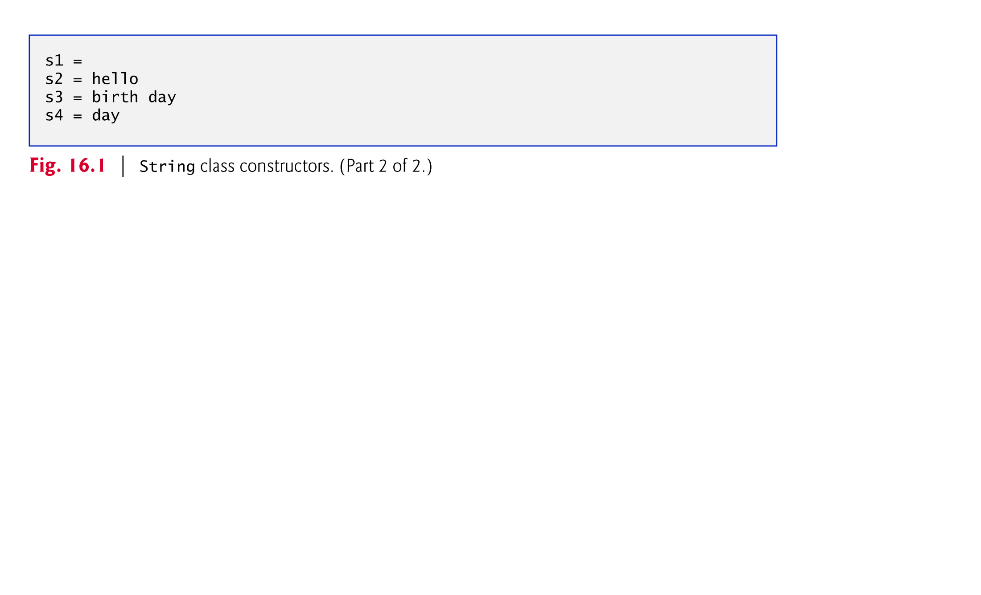

Slide 10
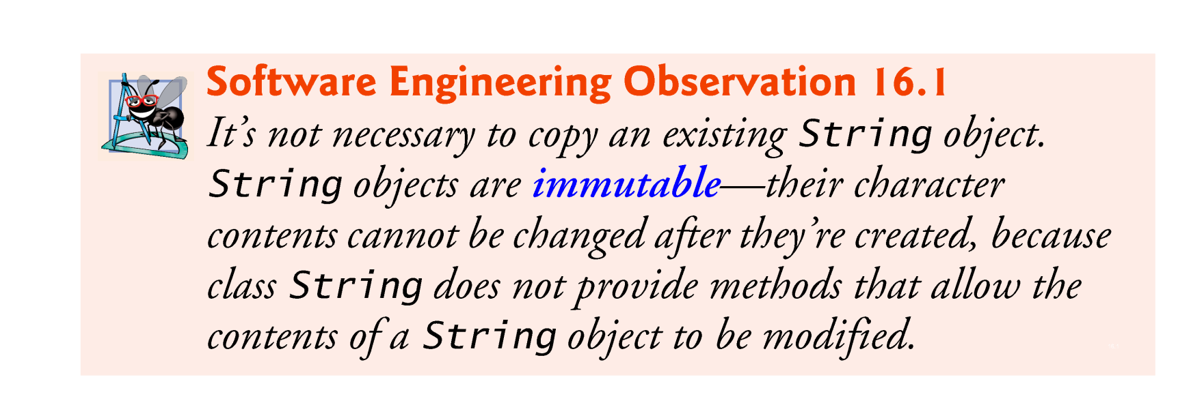

Slide 11
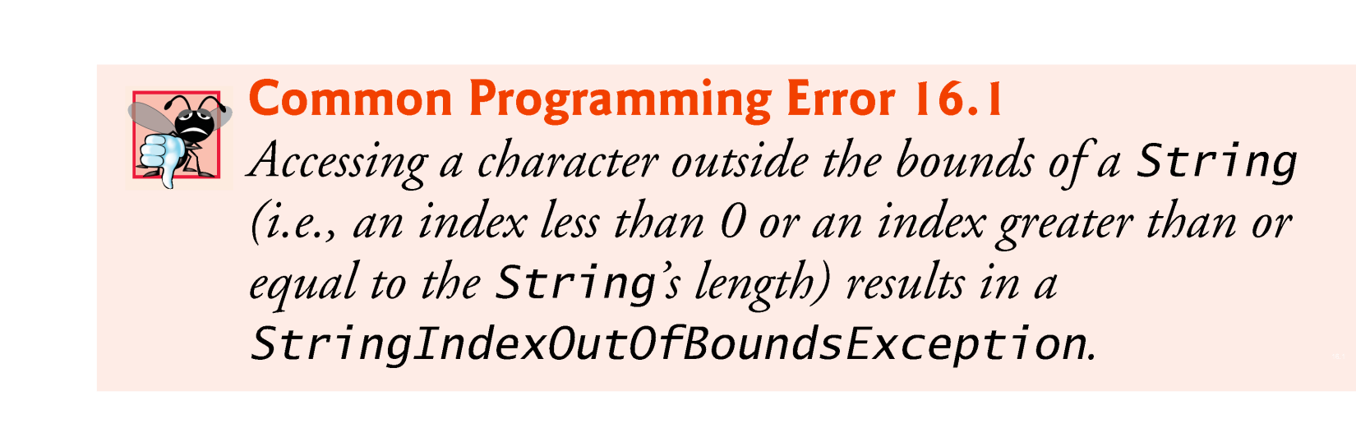

Slide 12
14.3.2 String Methods length, charAt and getChars
String method length determines the number of characters in a string.
String method charAt returns the character at a specific position in the String.
String method getChars copies the characters of a String into a character array.
The first argument is the starting index in the String from which characters are to be copied.
The second that is one past the last character to be copied from the String. argument is the index
The third argument is the character array into which the characters are to be copied.
The last argument is the starting index where the copied characters are placed in the target character array.

Slide 13
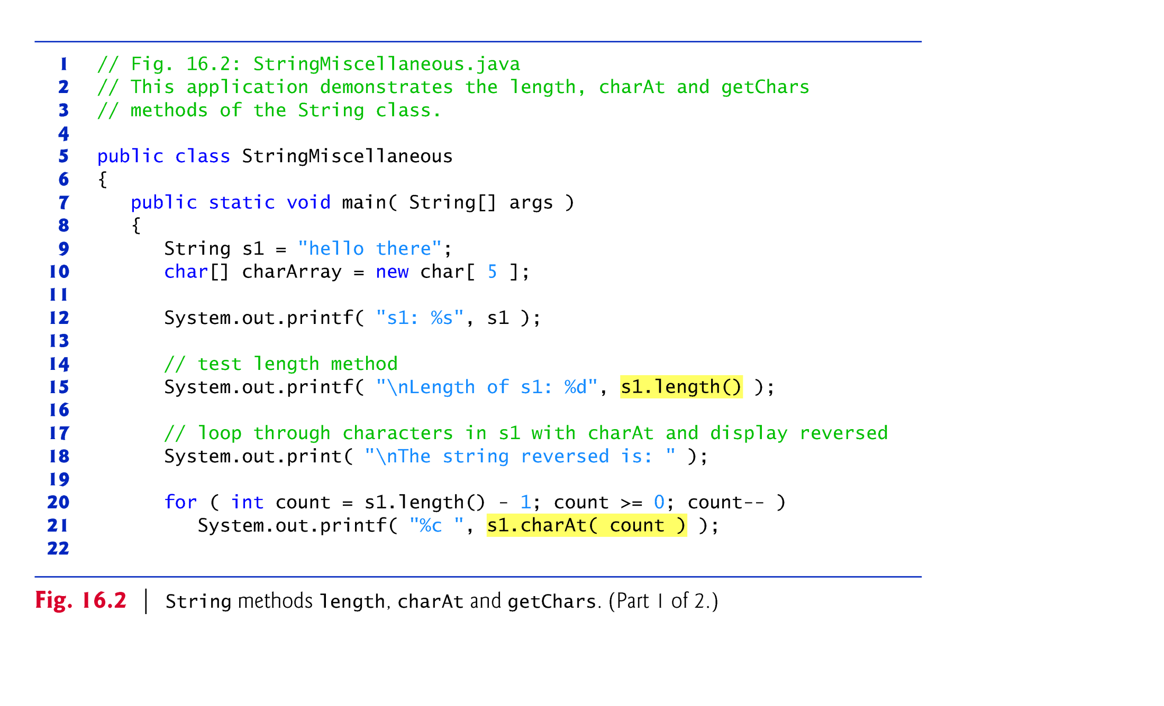

Slide 14
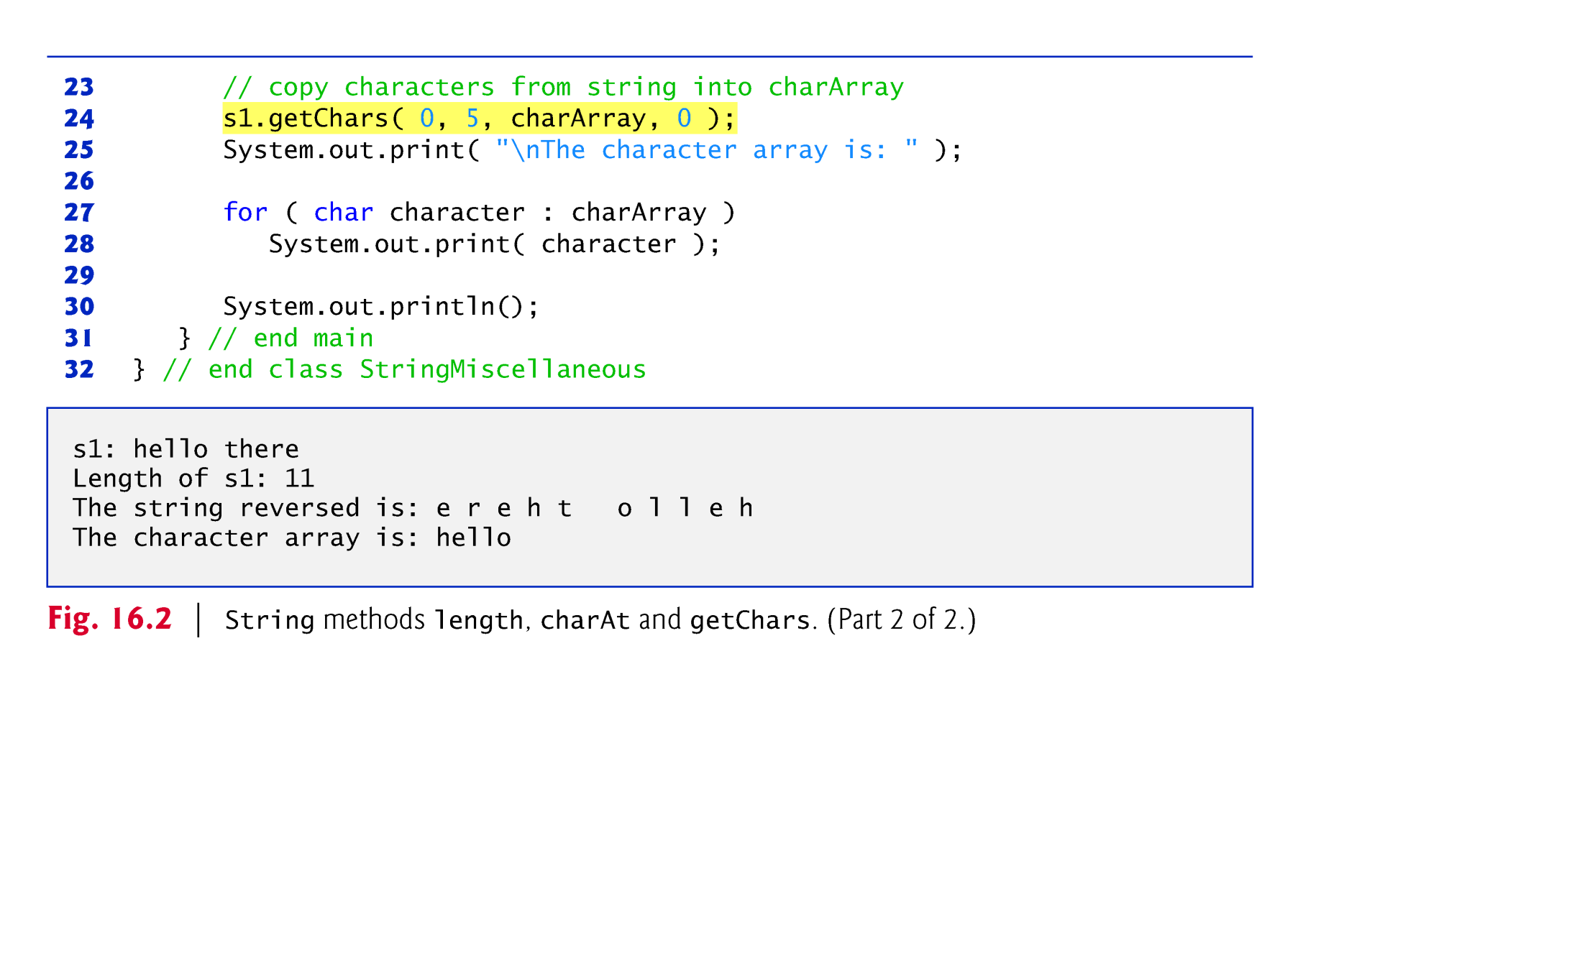

Slide 15
14.3.3 Comparing Strings
Strings are compared using the numeric codes of the characters in the strings.
Figure 14.3 demonstrates String methods equals, equalsIgnoreCase, compareTo and regionMatches and using the equality operator == to compare String objects.

Slide 16
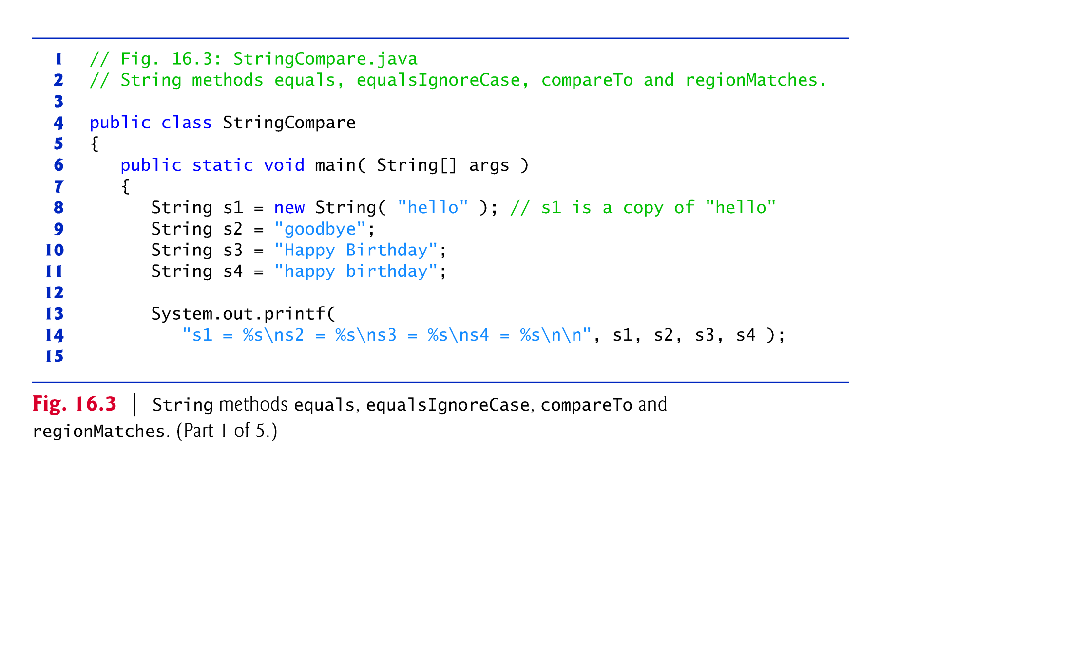

Slide 17
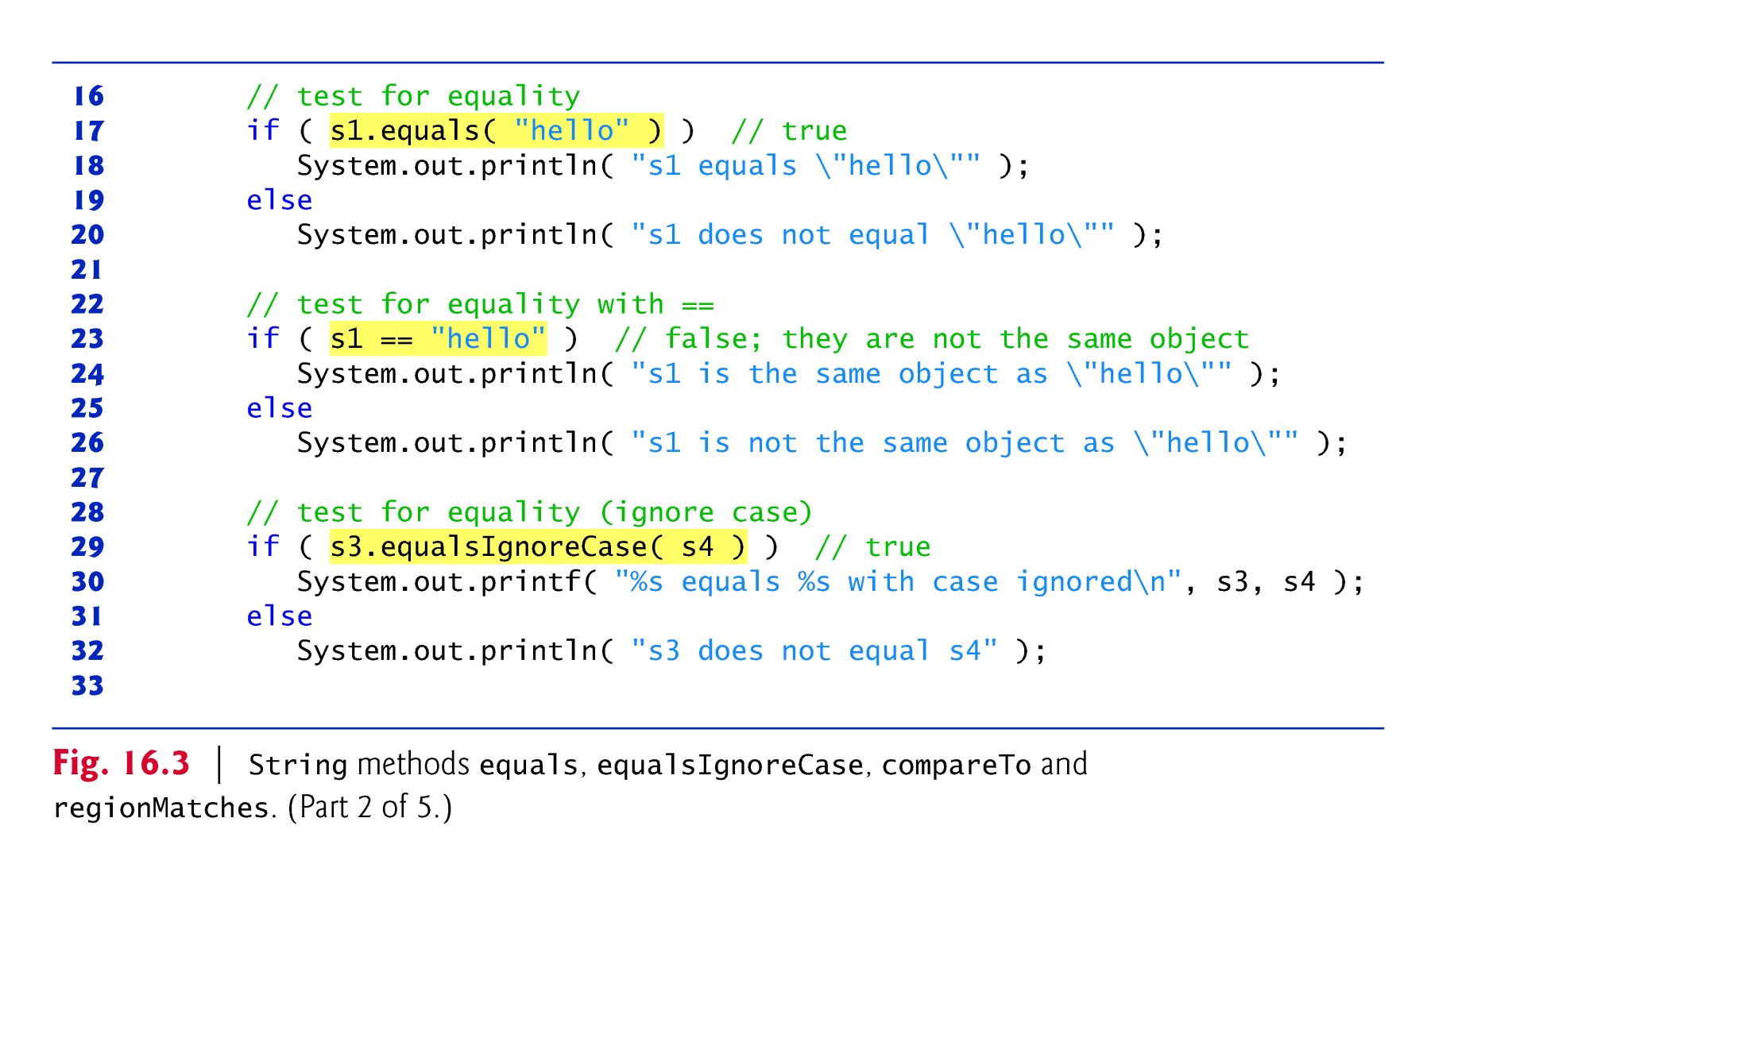

Slide 18
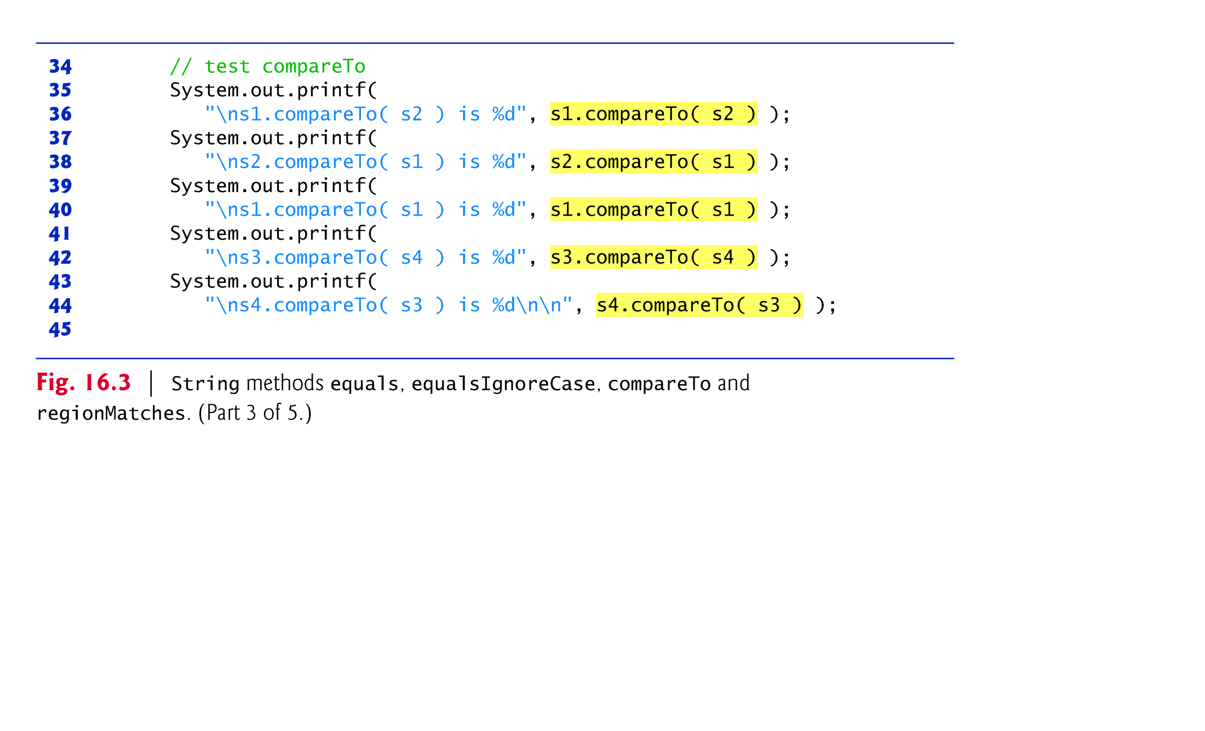

Slide 19
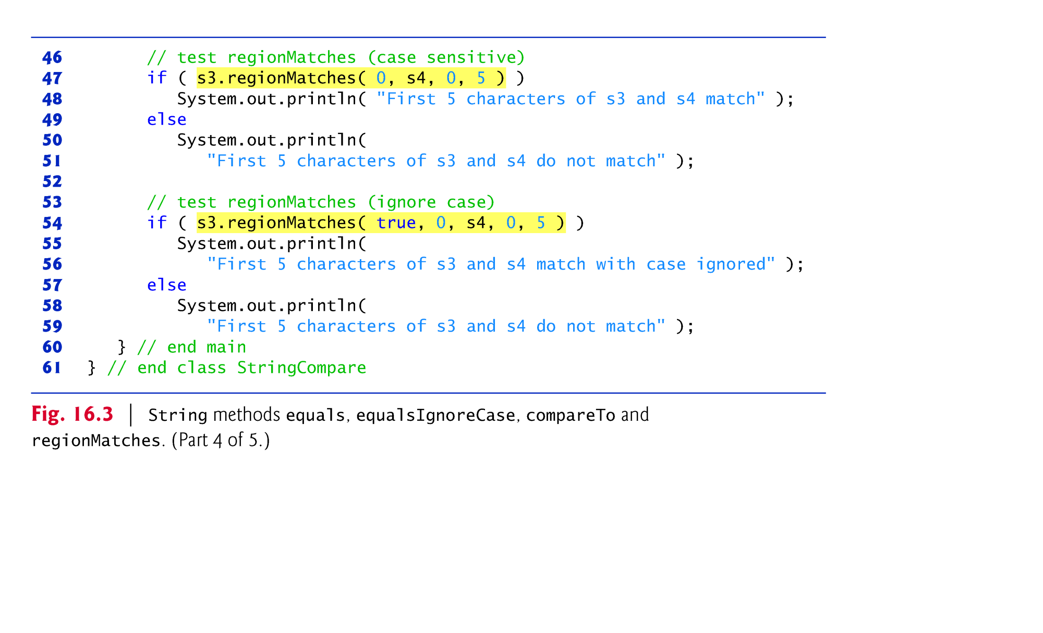

Slide 20
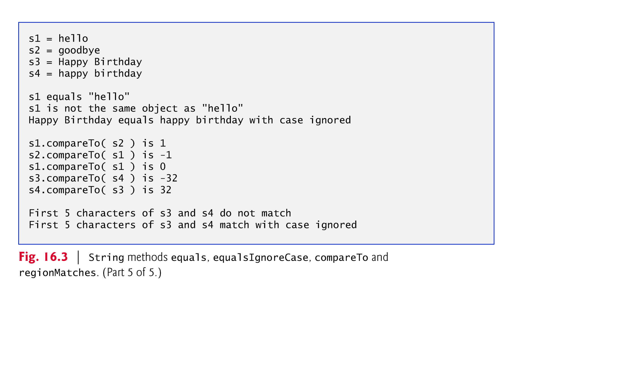

Slide 21
14.3.3 Comparing Strings (cont.)
String methods startsWith and endsWith determine whether strings start with or end with a particular set of characters

Slide 22
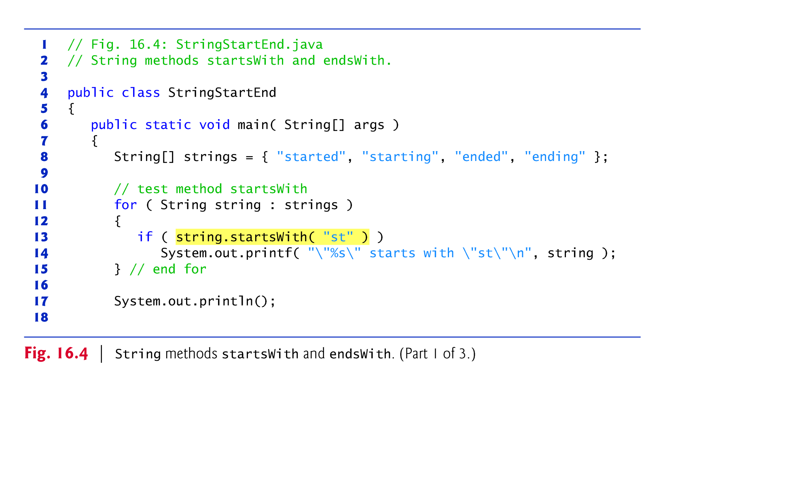

Slide 23
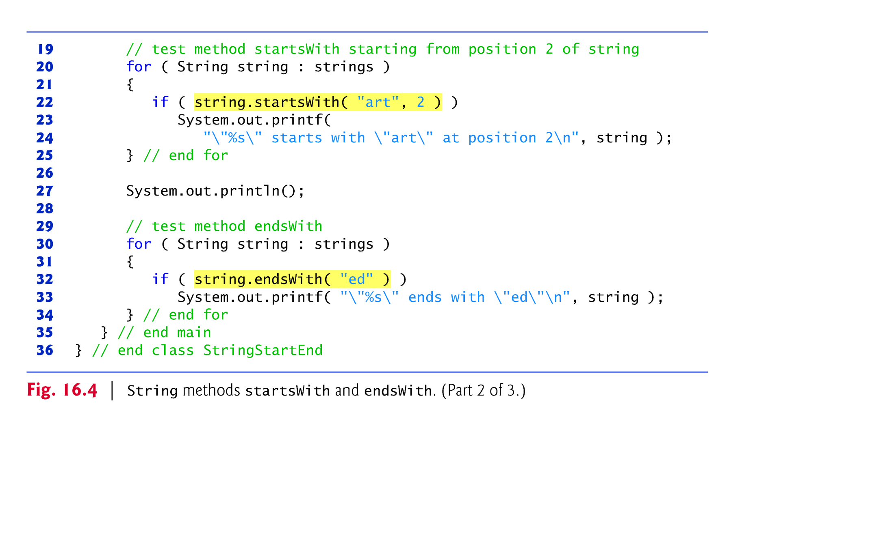

Slide 24
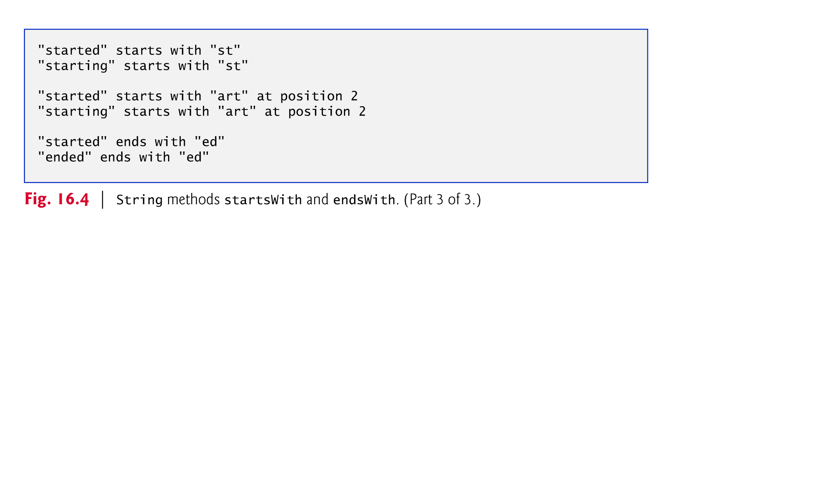

Slide 25
14.3.4 Locating Characters and Substrings in Strings
Figure 14.5 demonstrates the many versions of String methods indexOf and lastIndexOf that search for a specified character or substring in a String.

Slide 26
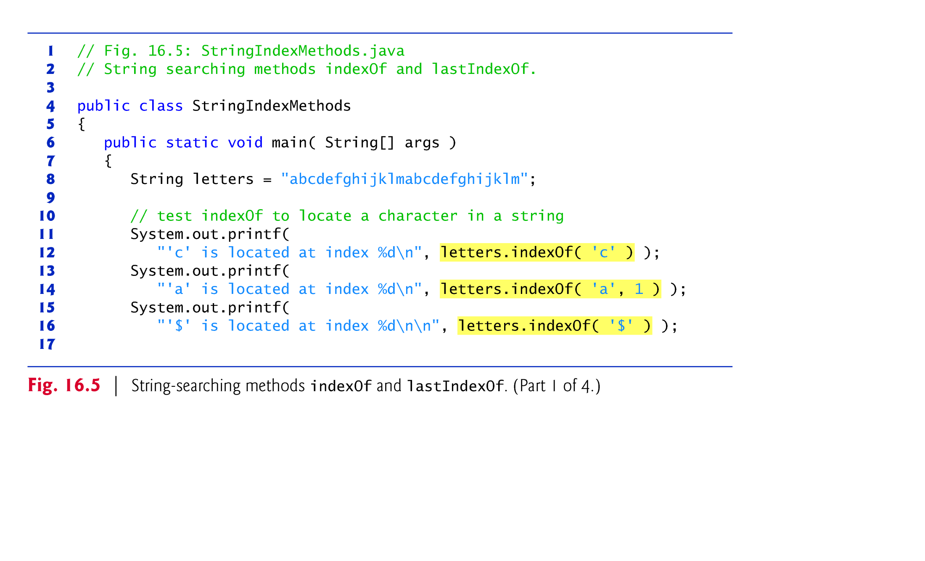

Slide 27
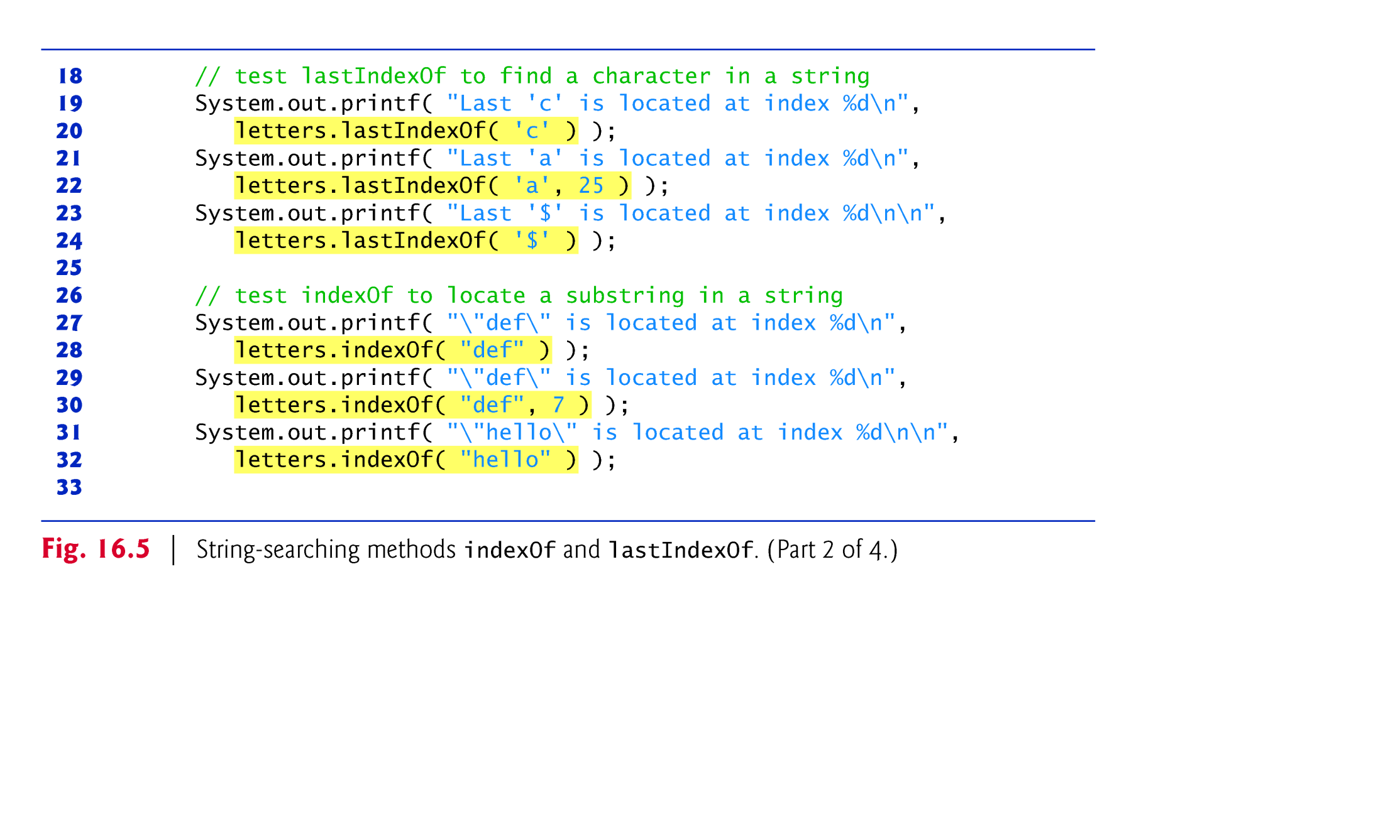

Slide 28
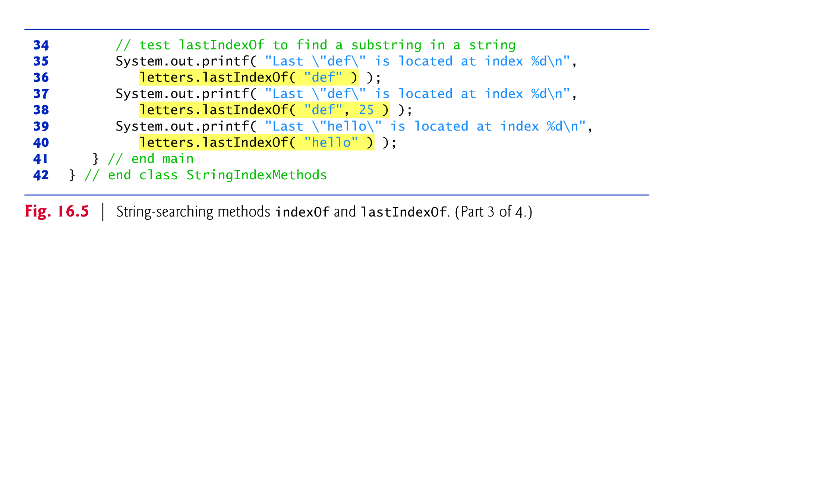

Slide 29
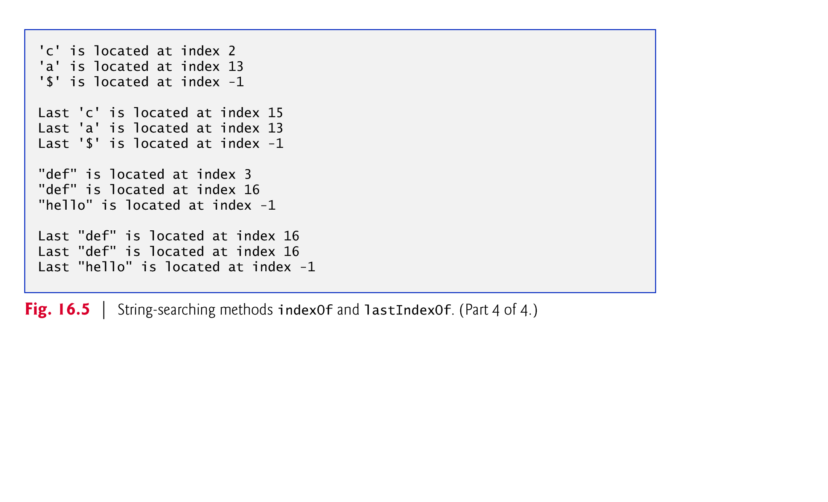

Slide 30
14.3.5 Extracting Substrings from Strings
Class String provides two substring methods to enable a new String object to be created by copying part of an existing String object. Each method returns a new String object.

Slide 31
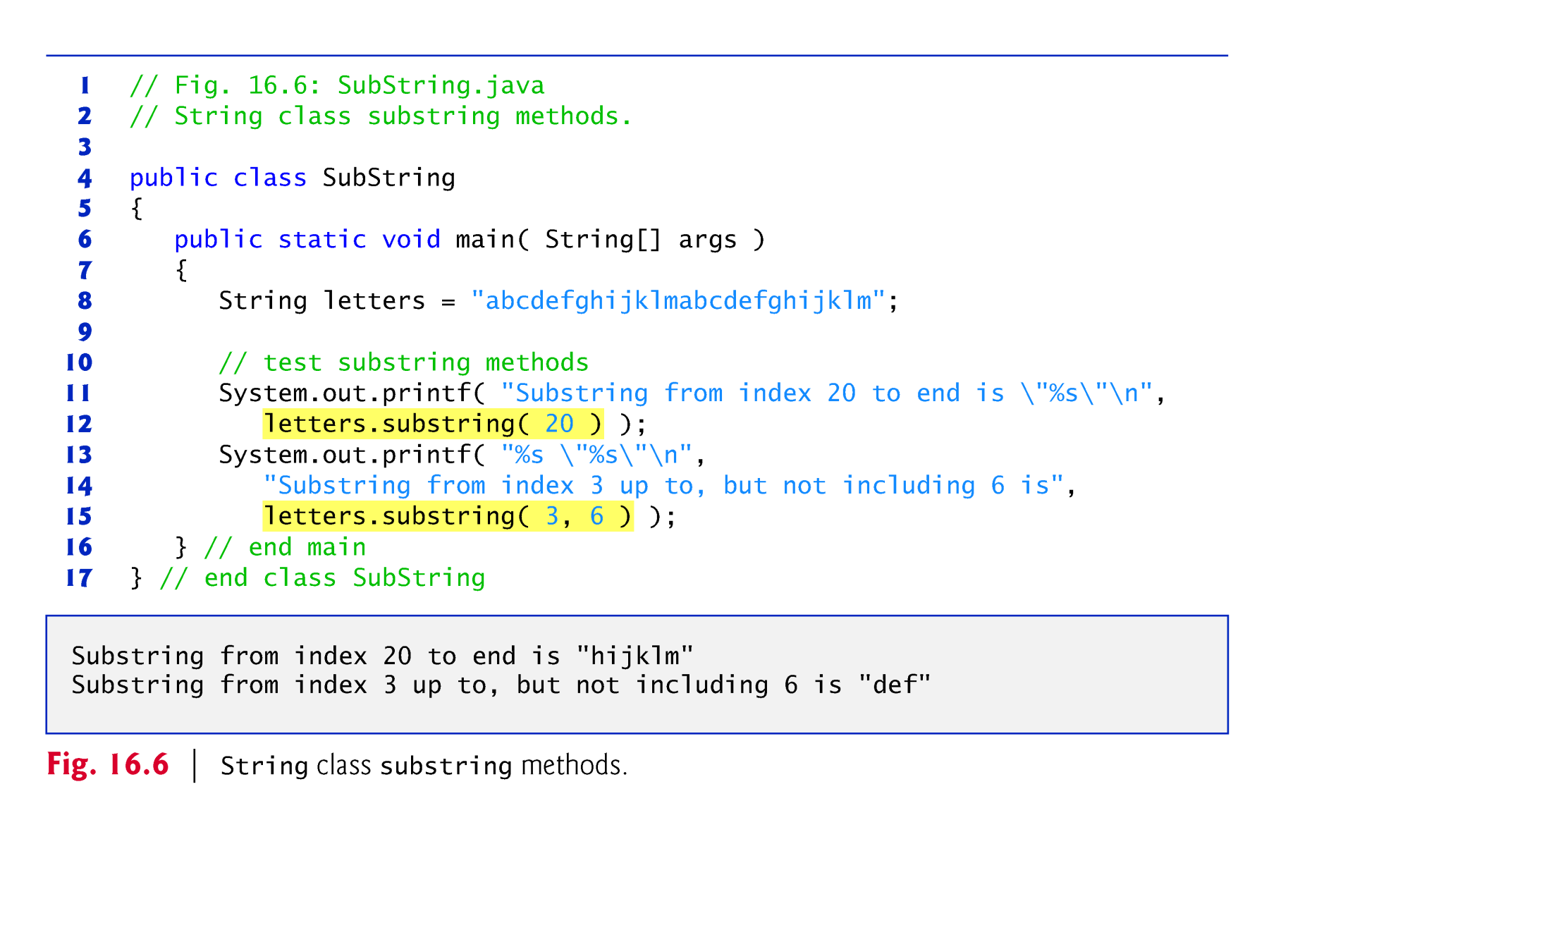

Slide 32
14.3.6 Concatenating Strings
String method concat concatenates two String objects and returns a new String object containing the characters from both original Strings.
The original Strings to which s1 and s2 refer are not modified.

Slide 33
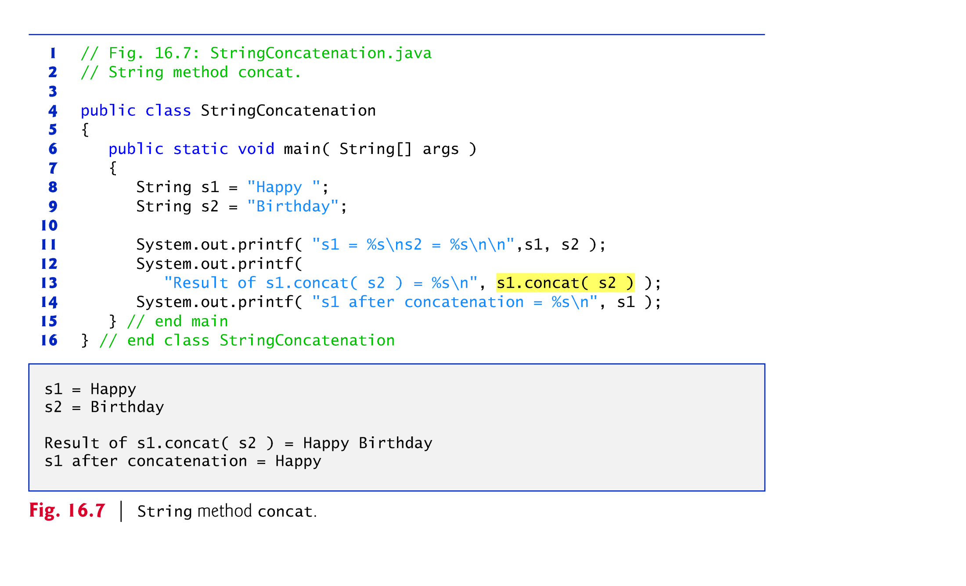

Slide 34
14.3.7 Miscellaneous String Methods
Method replace return a new String object in which every occurrence of the first char argument is replaced with the second.
An overloaded version enables you to replace substrings rather than individual characters.
Method toUpperCase generates a new String with uppercase letters.
Method toLowerCase returns a new String object with lowercase letters.
Method trim generates a new String object that removes all whitespace characters that appear at the beginning or end of the String on which trim operates.
Method toCharArray creates a new character array containing a copy of the characters in the String.

Slide 35
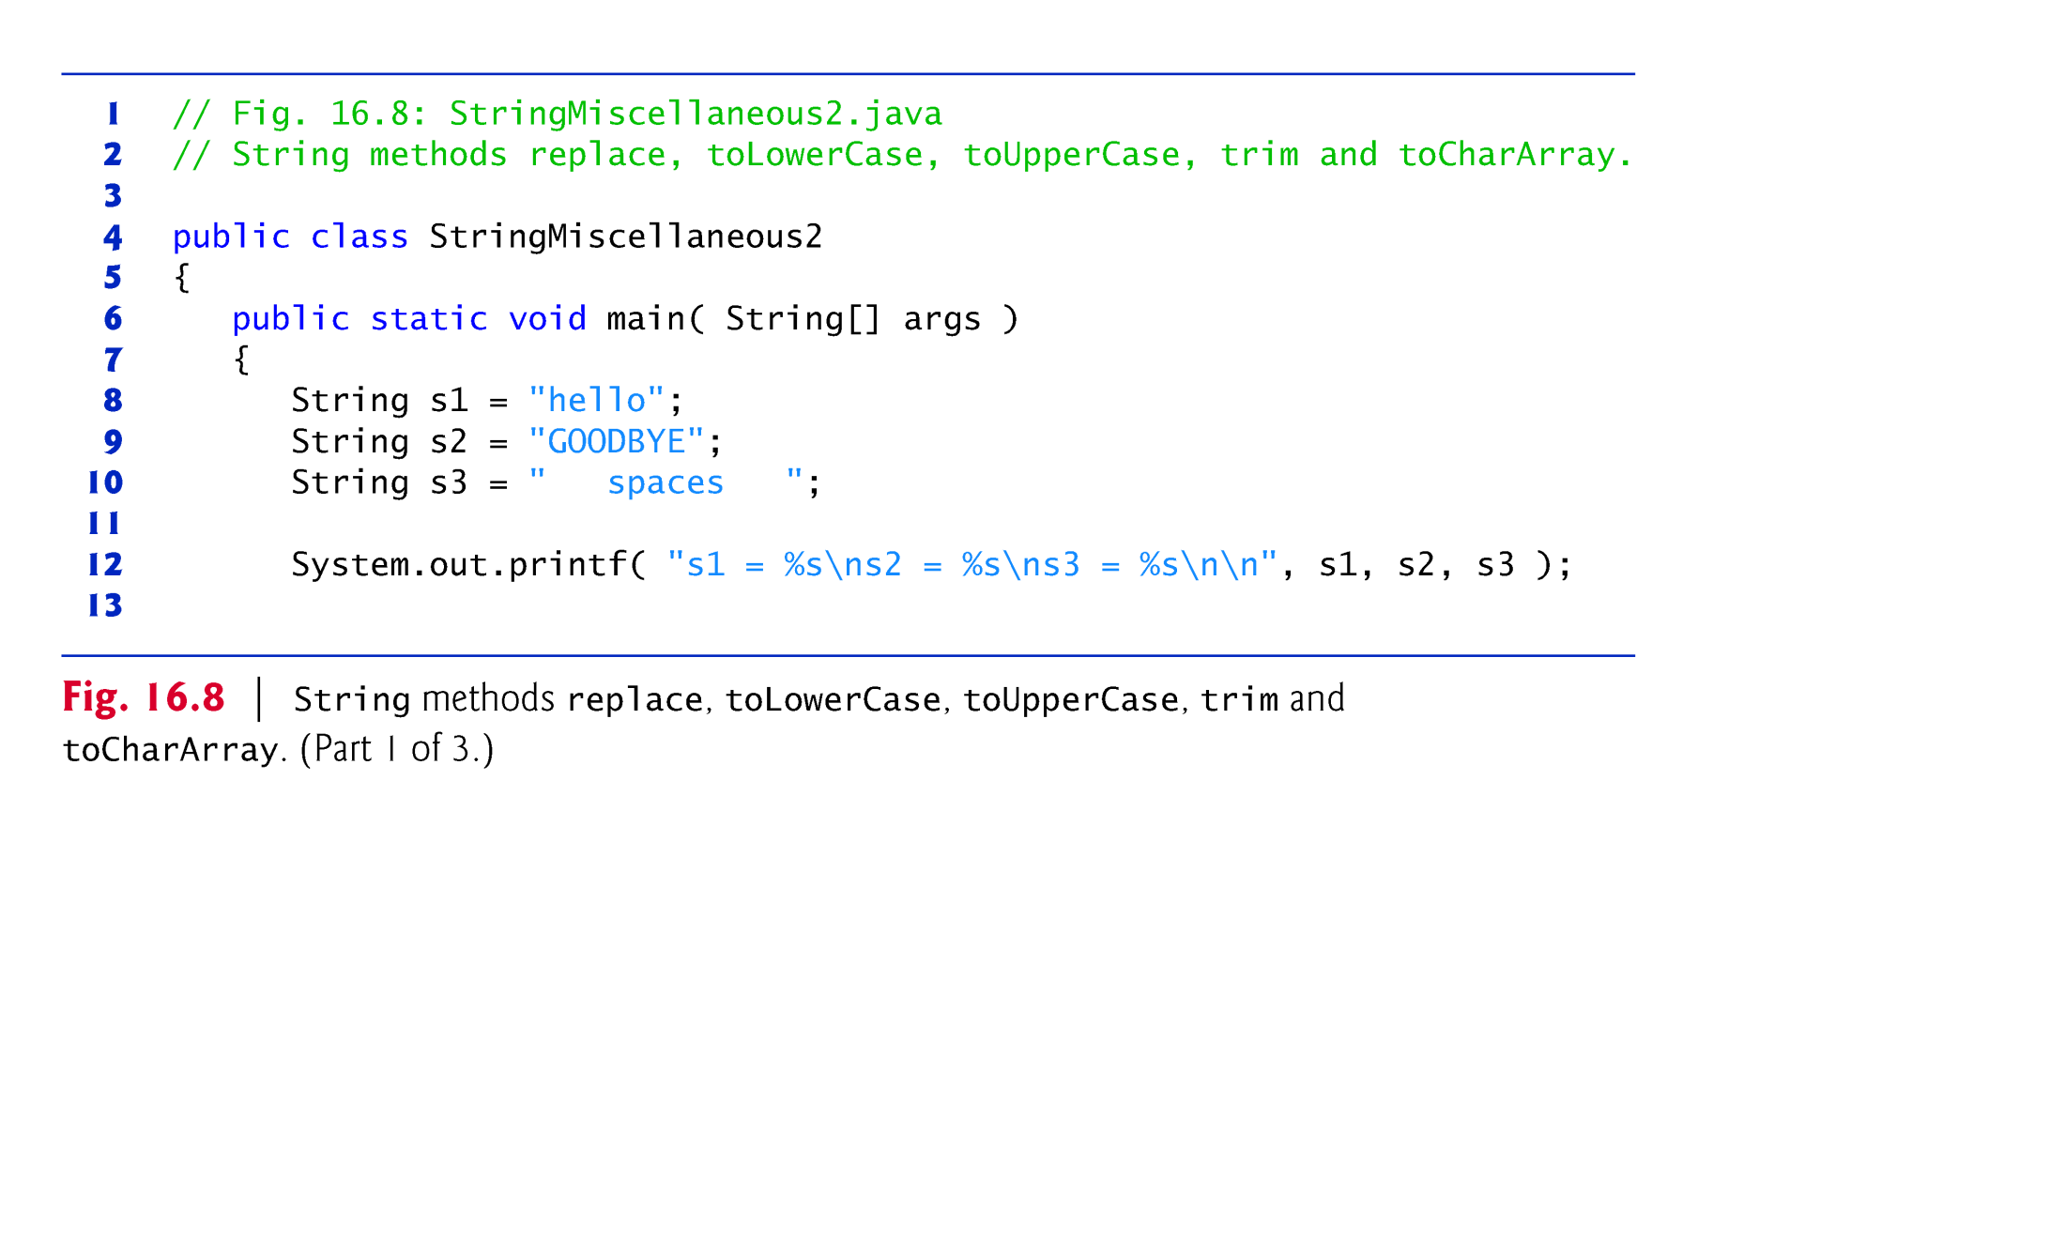

Slide 36
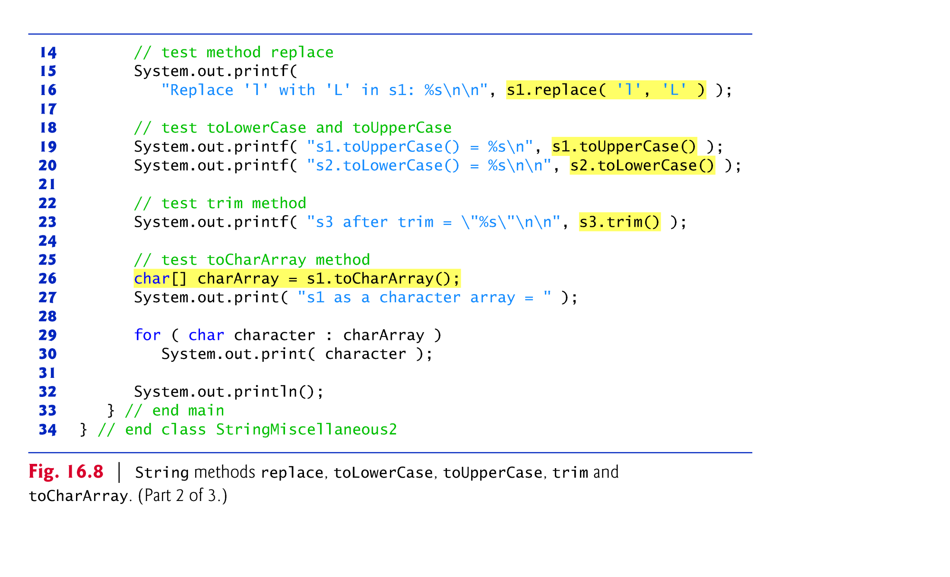

Slide 37
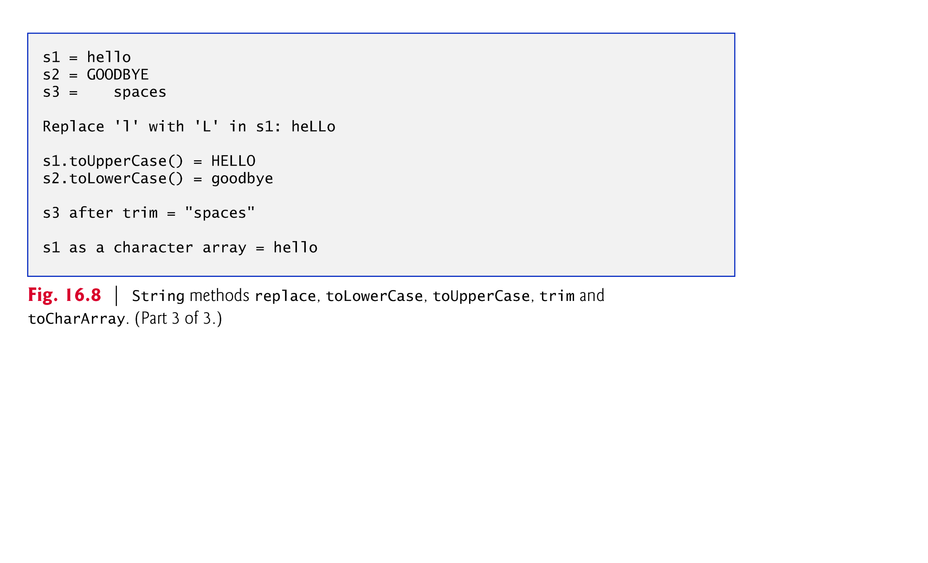

Slide 38
14.3.8 String Method valueOf
Class String provides static valueOf methods that take an argument of any type and convert it to a String object.
Class StringBuilder is used to create and manipulate dynamic string information.
Every StringBuilder is capable of storing a number of characters specified by its capacity.
If the capacity of a StringBuilder is exceeded, the capacity expands to accommodate the additional characters.

Slide 39
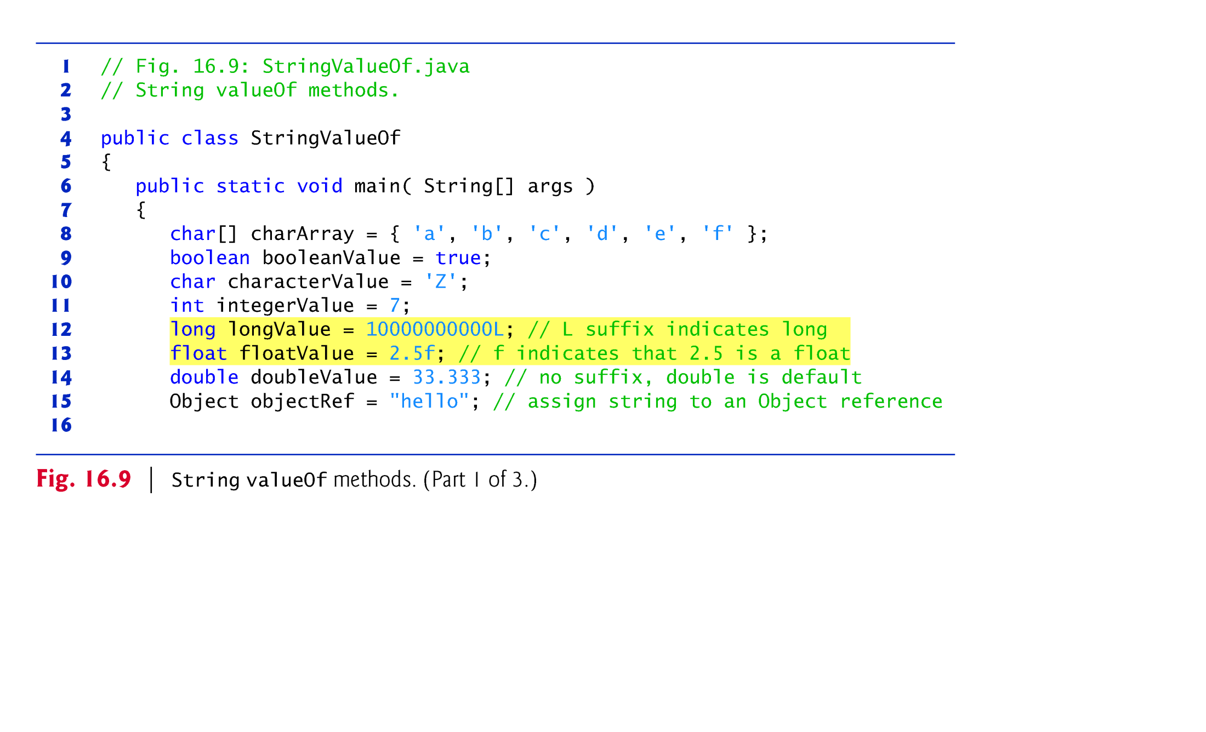

Slide 40
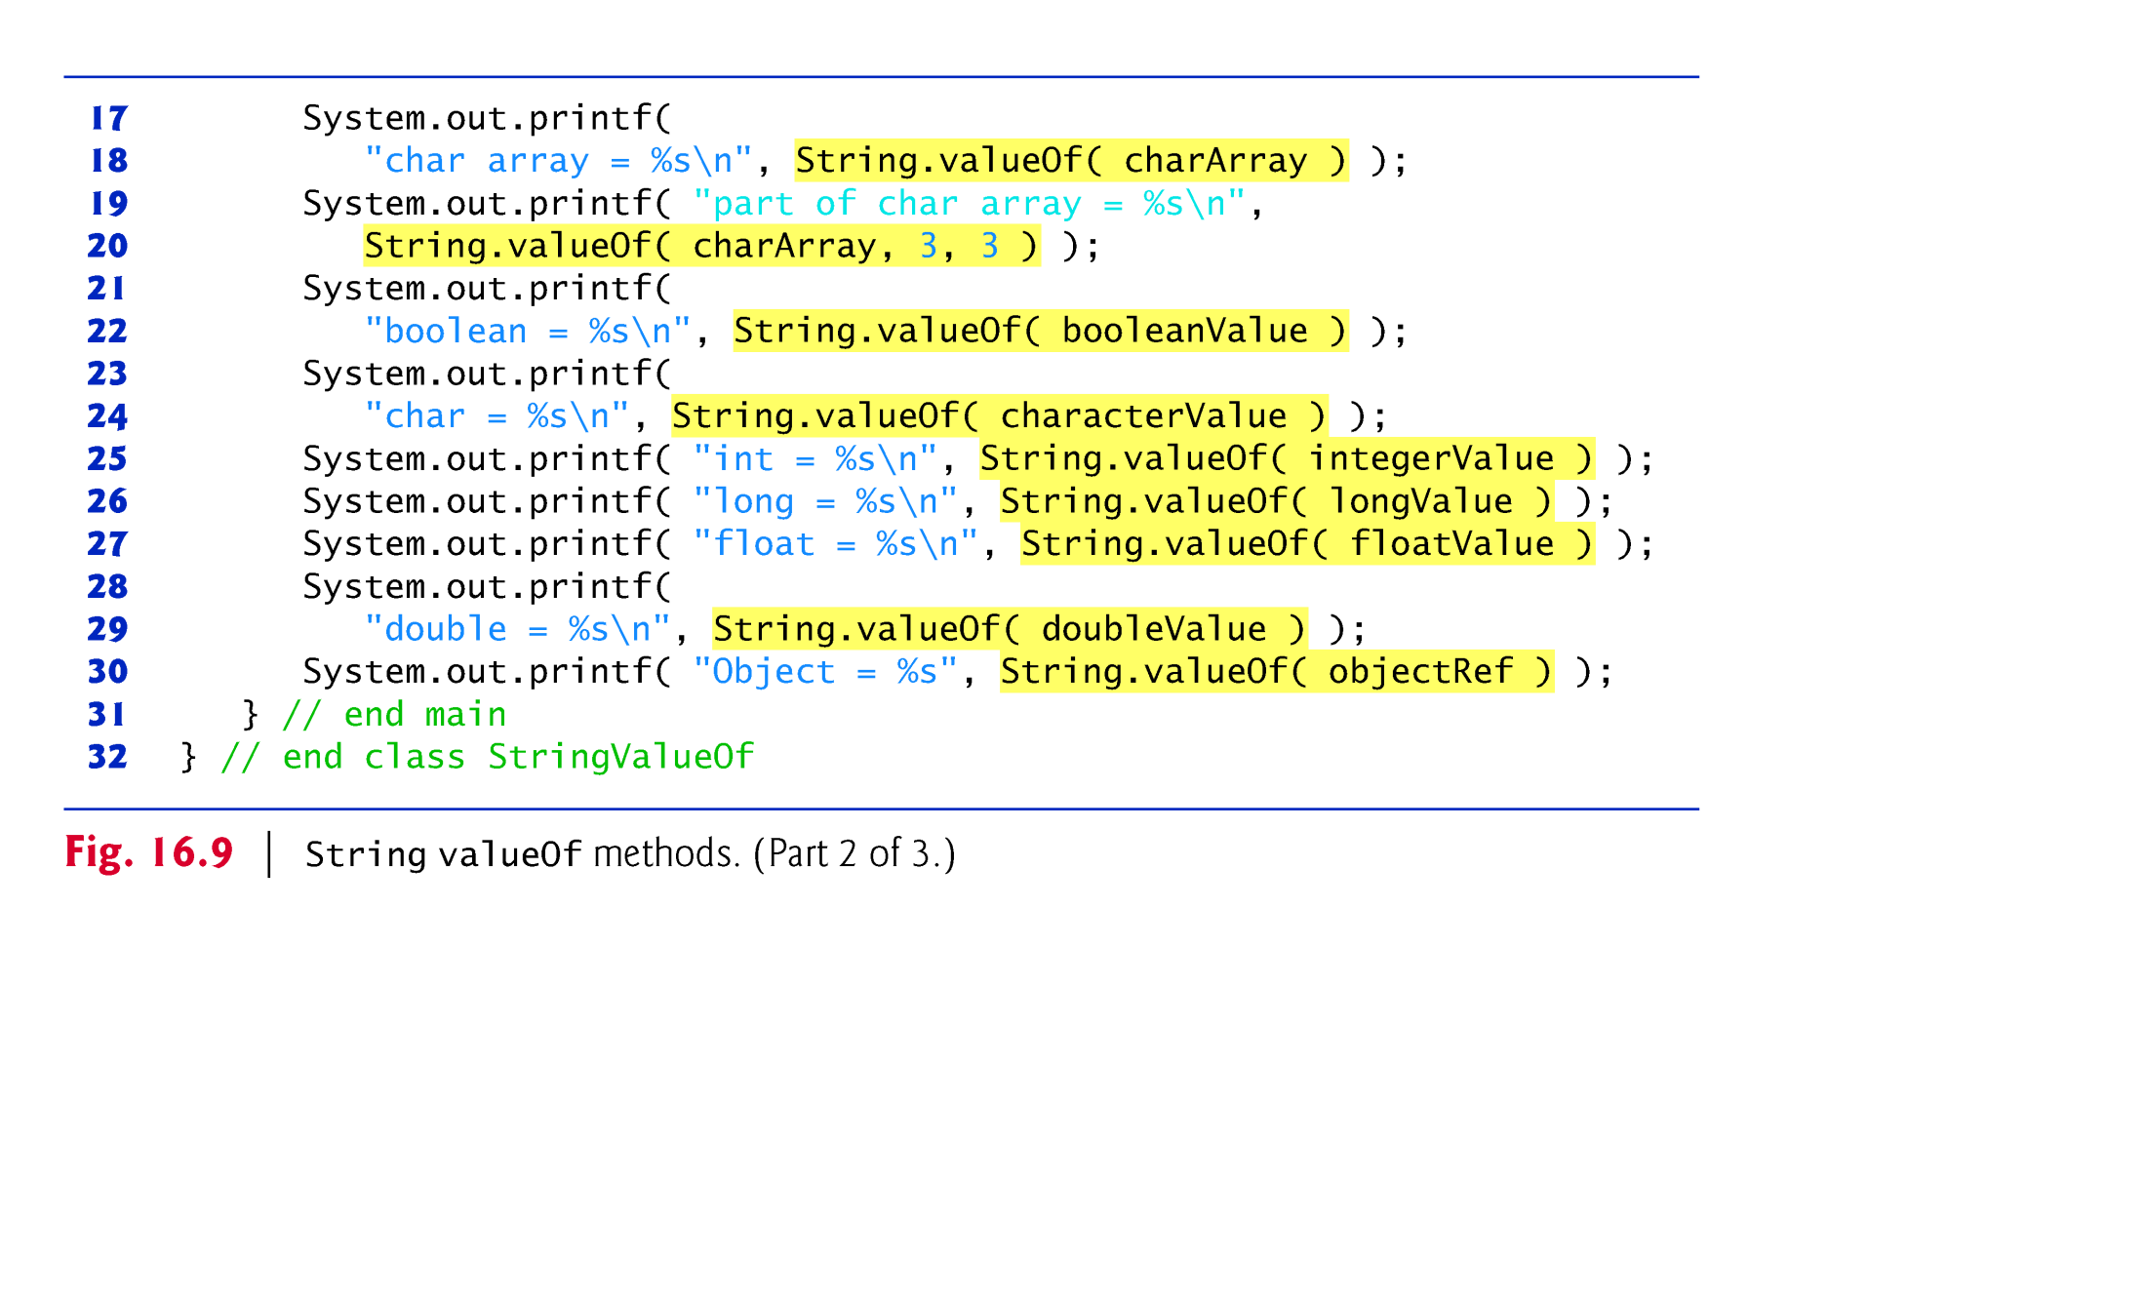

Slide 41
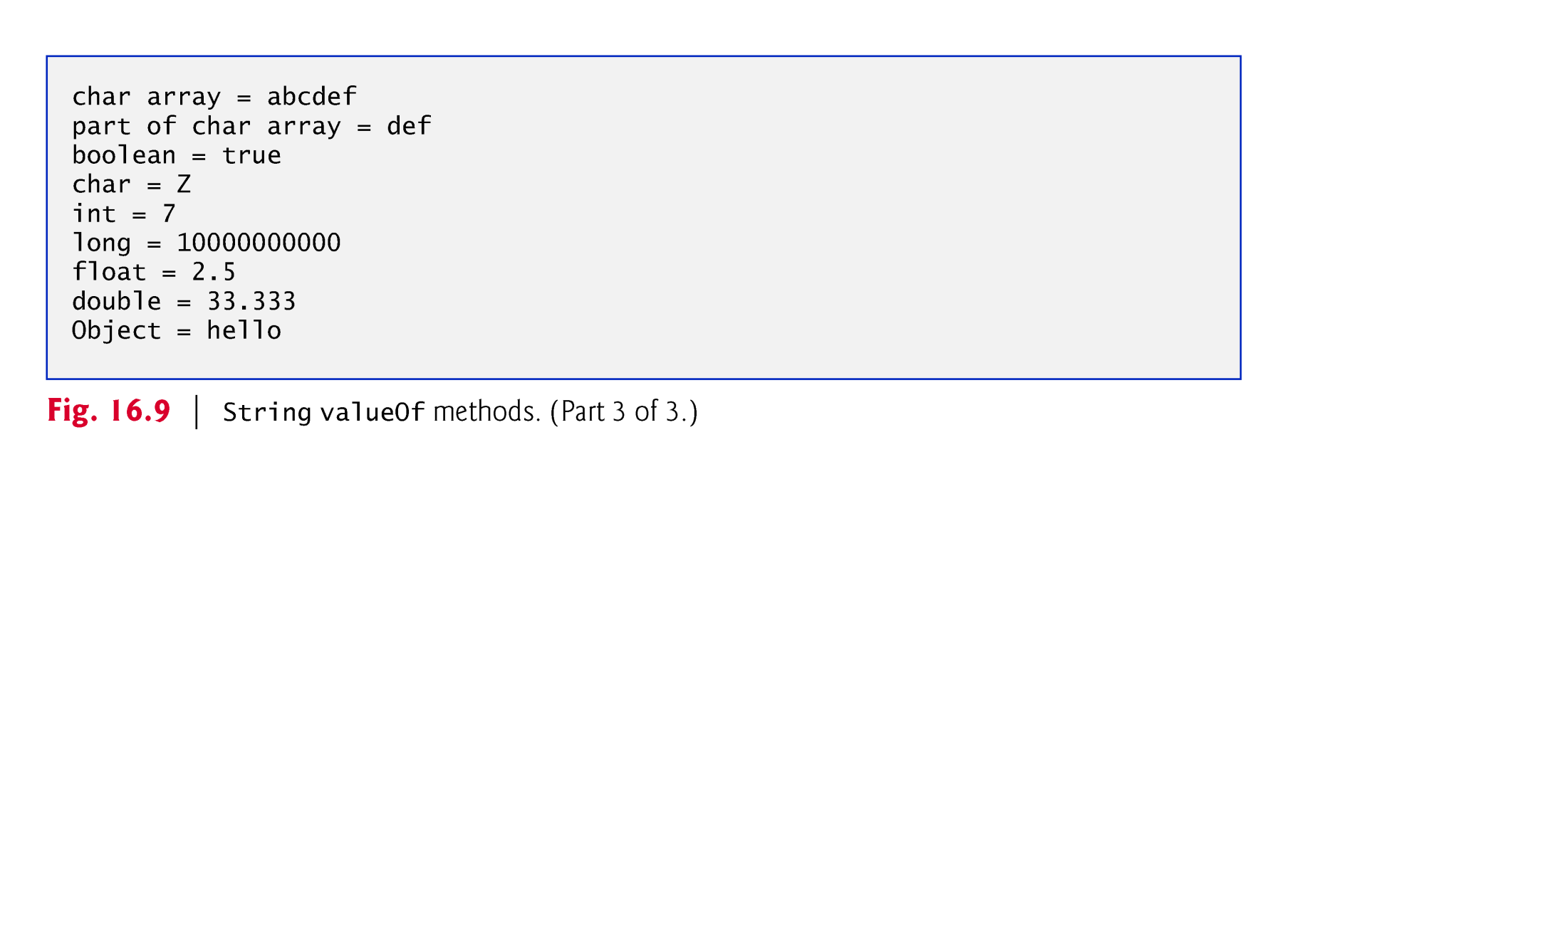

Slide 42
14.4 Class StringBuilder
We now discuss the features of class StringBuilder for creating and manipulating dynamic string information—that is, modifiable strings.
Every StringBuilder is capable of storing a number of characters specified by it’s capacity.
If a StringBuilder‘s capacity is exceeded, the capacity expands to accommodate additional characters.
Notes:
StringBuilder类提供一个与 StringBuffer 兼容的 API，但不保证同步。该类被设计用作 StringBuffer 的一个简易替换，用在字符串缓冲区被单个线程使用的时候（这种情况很普遍）。如果可能，建议优先采用该类，因为在大多数实现中，它比 StringBuffer 要快。

Slide 43
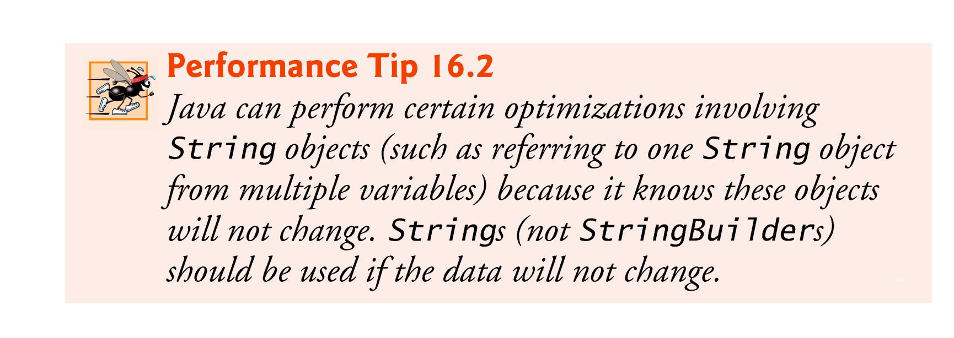

Slide 44
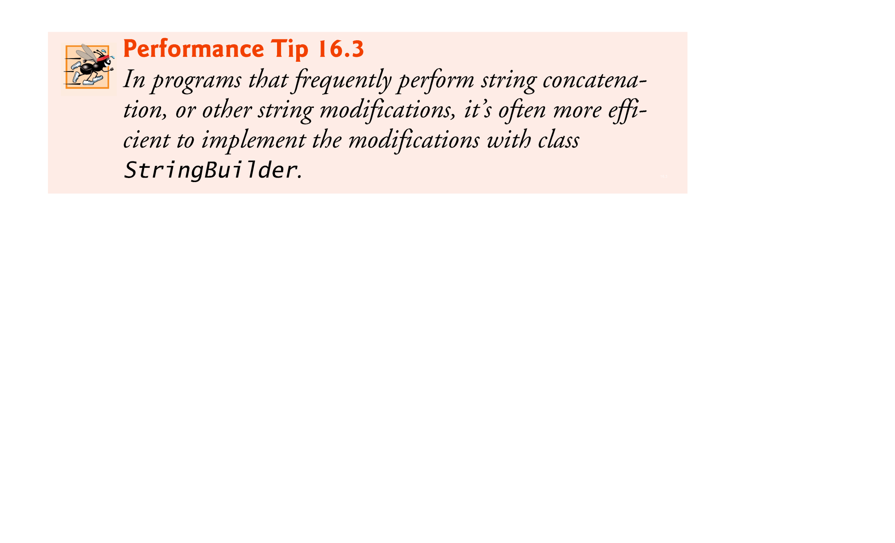

Slide 45
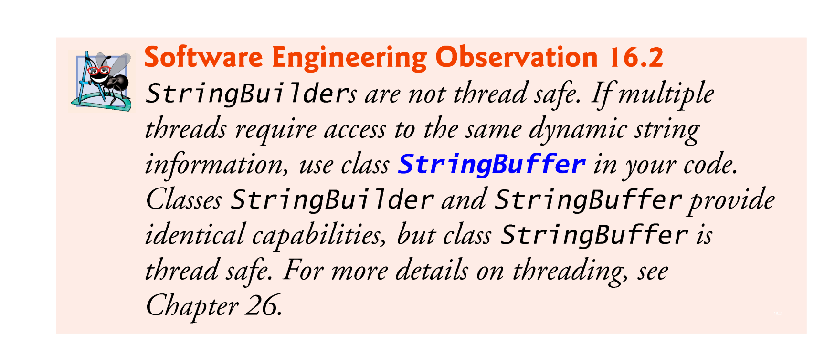

Slide 46
14.4.1 StringBuilder Constructors
StringBuilder()
Constructs a string builder with no characters in it and an initial capacity of 16 characters.
StringBuilder(CharSequence seq)
Constructs a string builder that contains the same characters as the specified CharSequence.
StringBuilder(int capacity)
Constructs a string builder with no characters in it and an initial capacity specified by the capacity argument.
StringBuilder(String str)
Constructs a string builder initialized to the contents of the specified string.

Slide 47
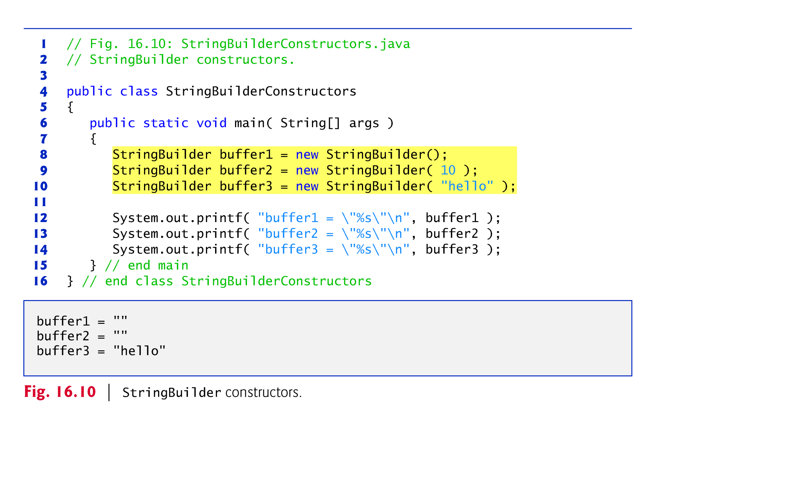

Slide 48
14.4.2 StringBuilder Methods length, capacity, setLength and ensureCapacity
Methods length and capacity return the number of characters currently in a StringBuilder and the number of characters that can be stored in a without allocating more memory, respectively.
Method ensureCapacity guarantees that a StringBuilder has at least the specified capacity.
Method setLength increases or decreases the length of a StringBuilder.
If the specified length is less than the current number of characters, the buffer is truncated to the specified length.
If the specified length is greater than the number of characters, null characters are appended until the total number of characters in the StringBuilder is equal to the specified length.

Slide 49
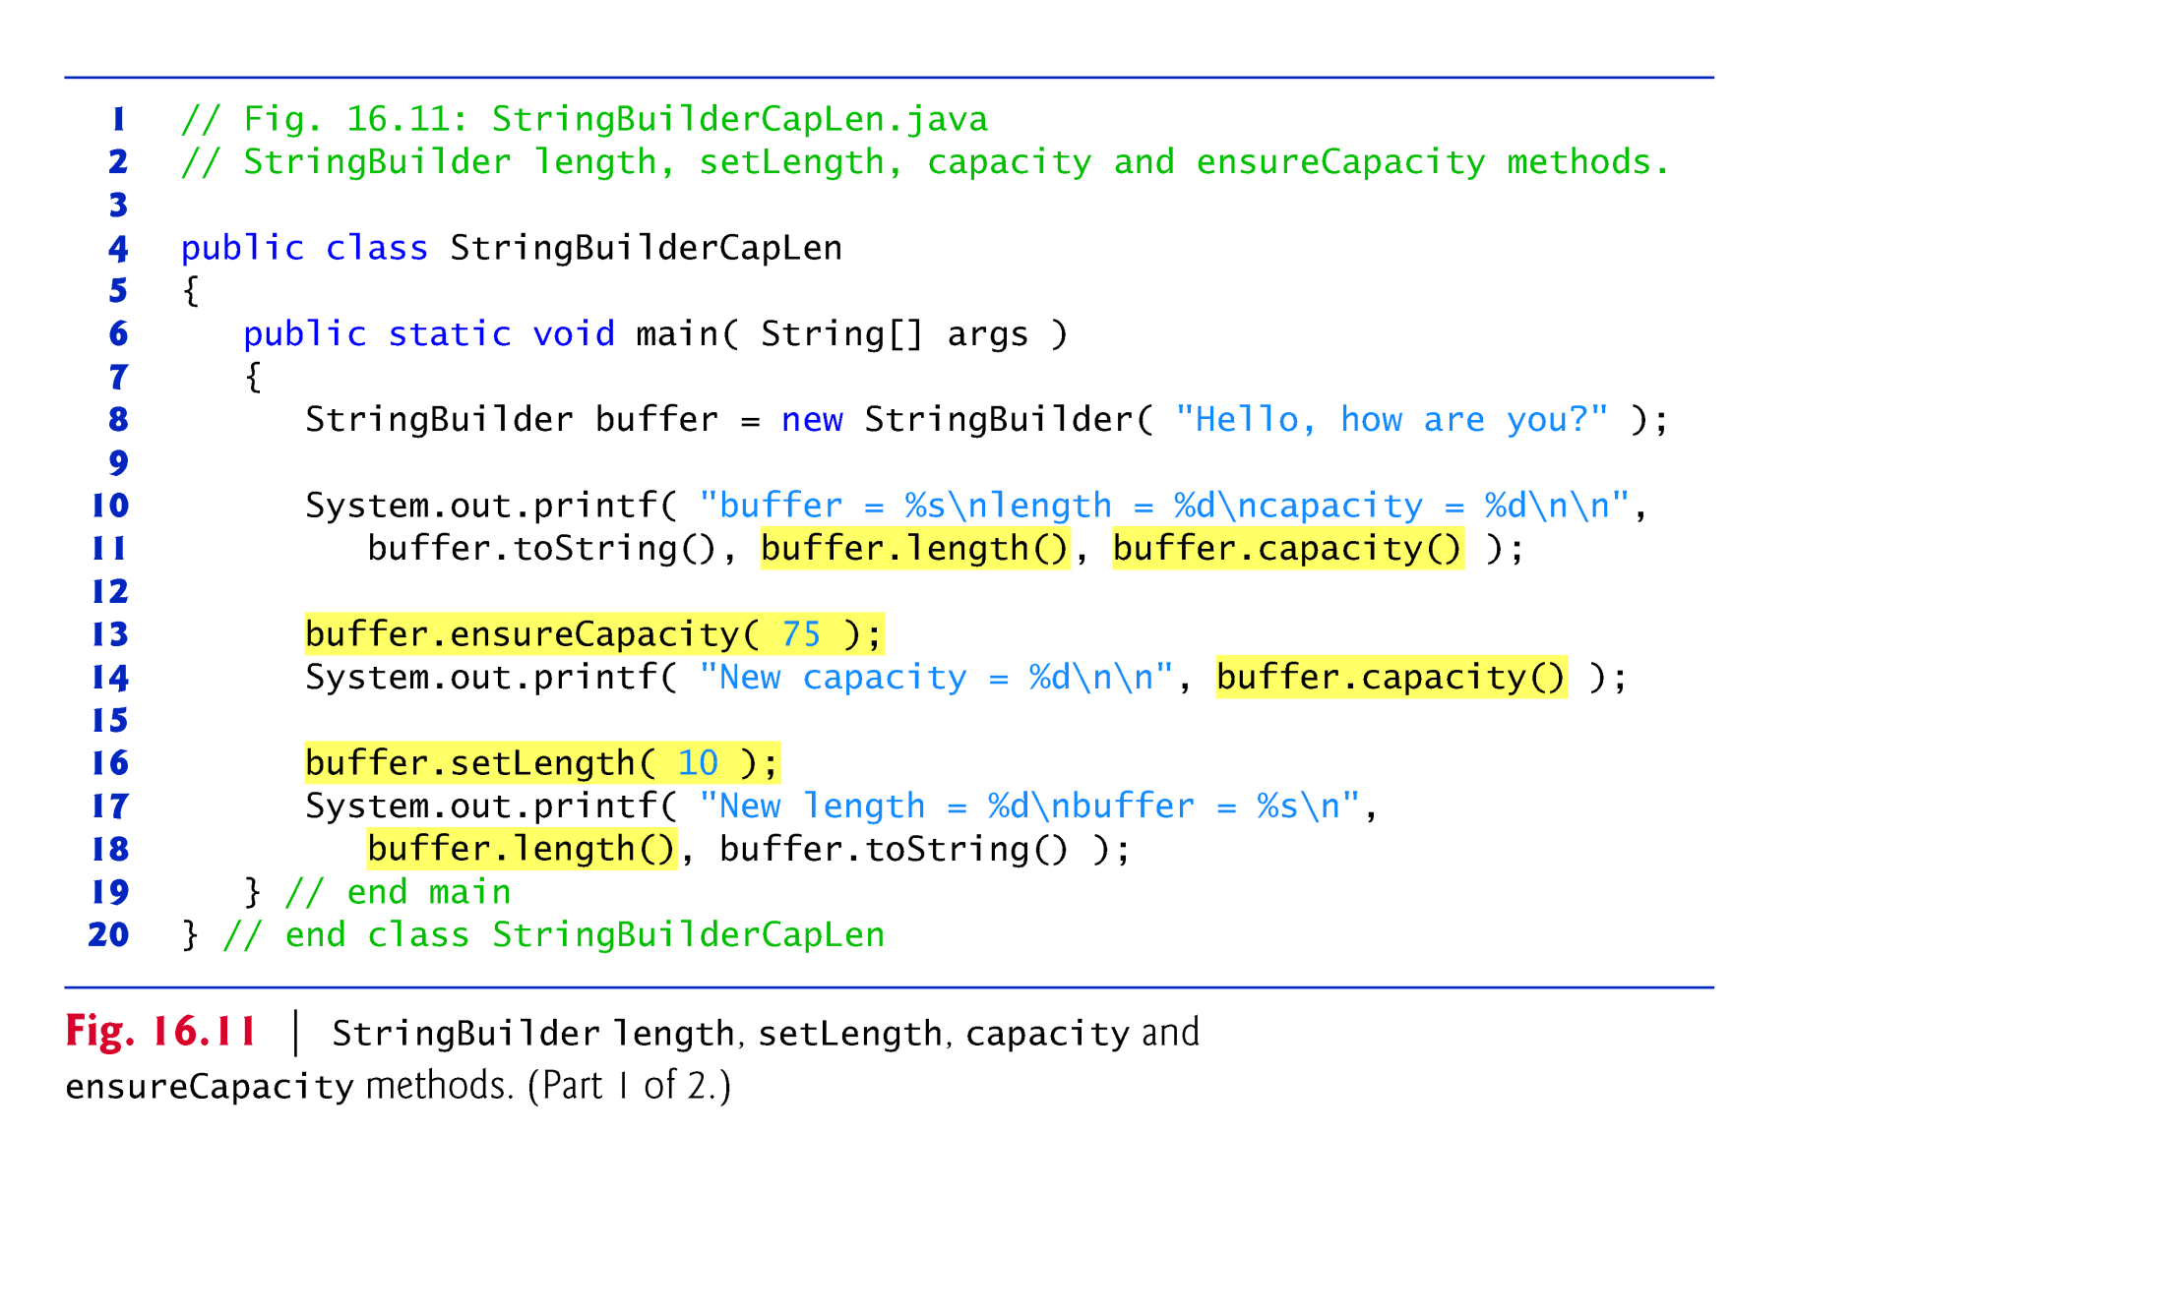

Slide 50
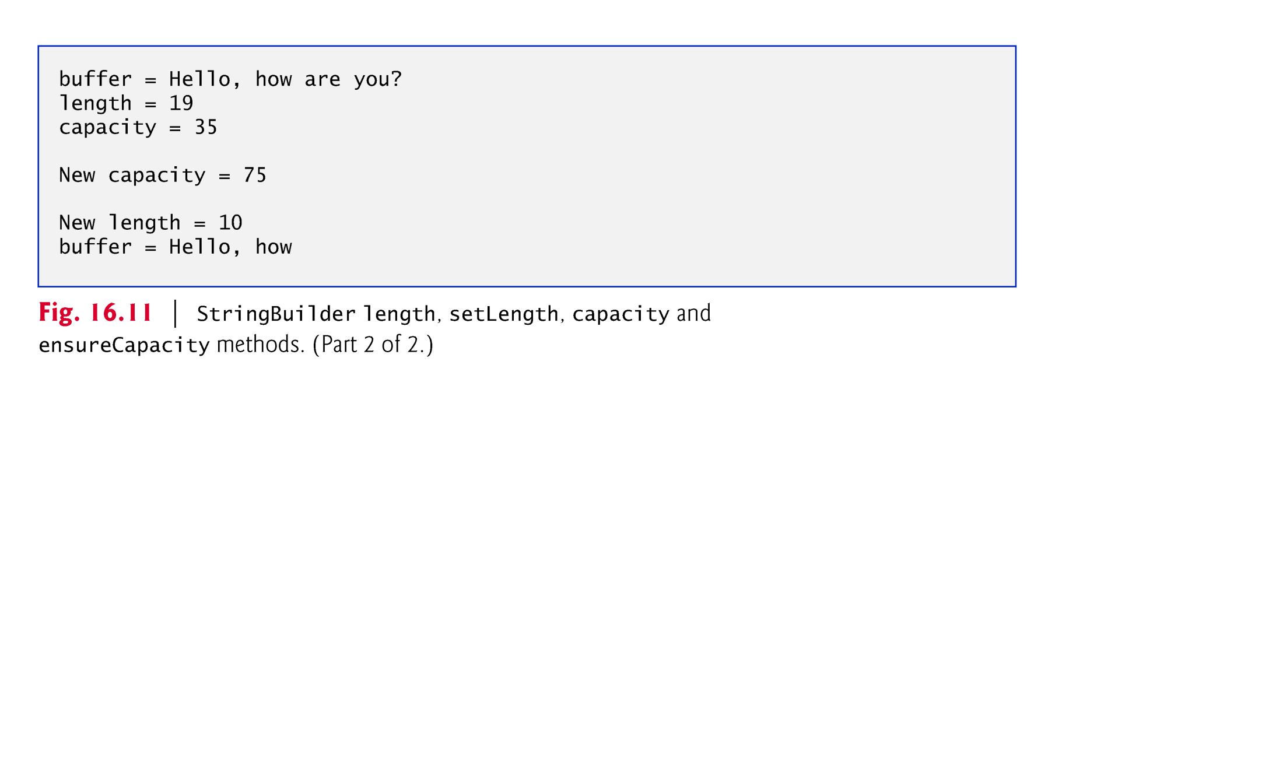

Slide 51
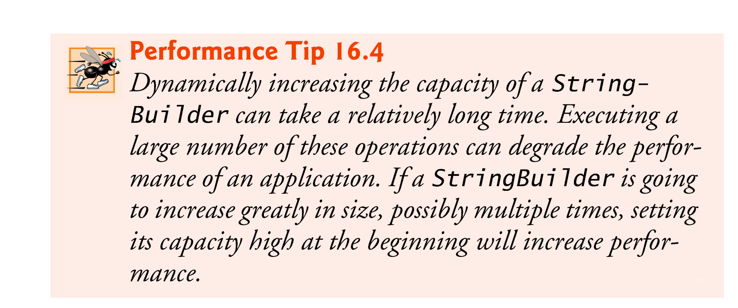

Slide 52
14.4.3 StringBuilder Methods charAt, setCharAt, getChars and reverse
Method charAt:
takes an integer argument and returns the character in the StringBuilder at that index.
Method getChars:
copies characters from a StringBuilder into the character array argument.
Four arguments—the starting index from which characters should be copied, the index one past the last character to be copied, the character array into which the characters are to be copied and the starting location in the character array where the first character should be placed.
Method setCharAt:
takes an integer and a character argument and sets the character at the specified position in the StringBuilder to the character argument.
Method reverse :
reverses the contents of the StringBuilder.

Slide 53
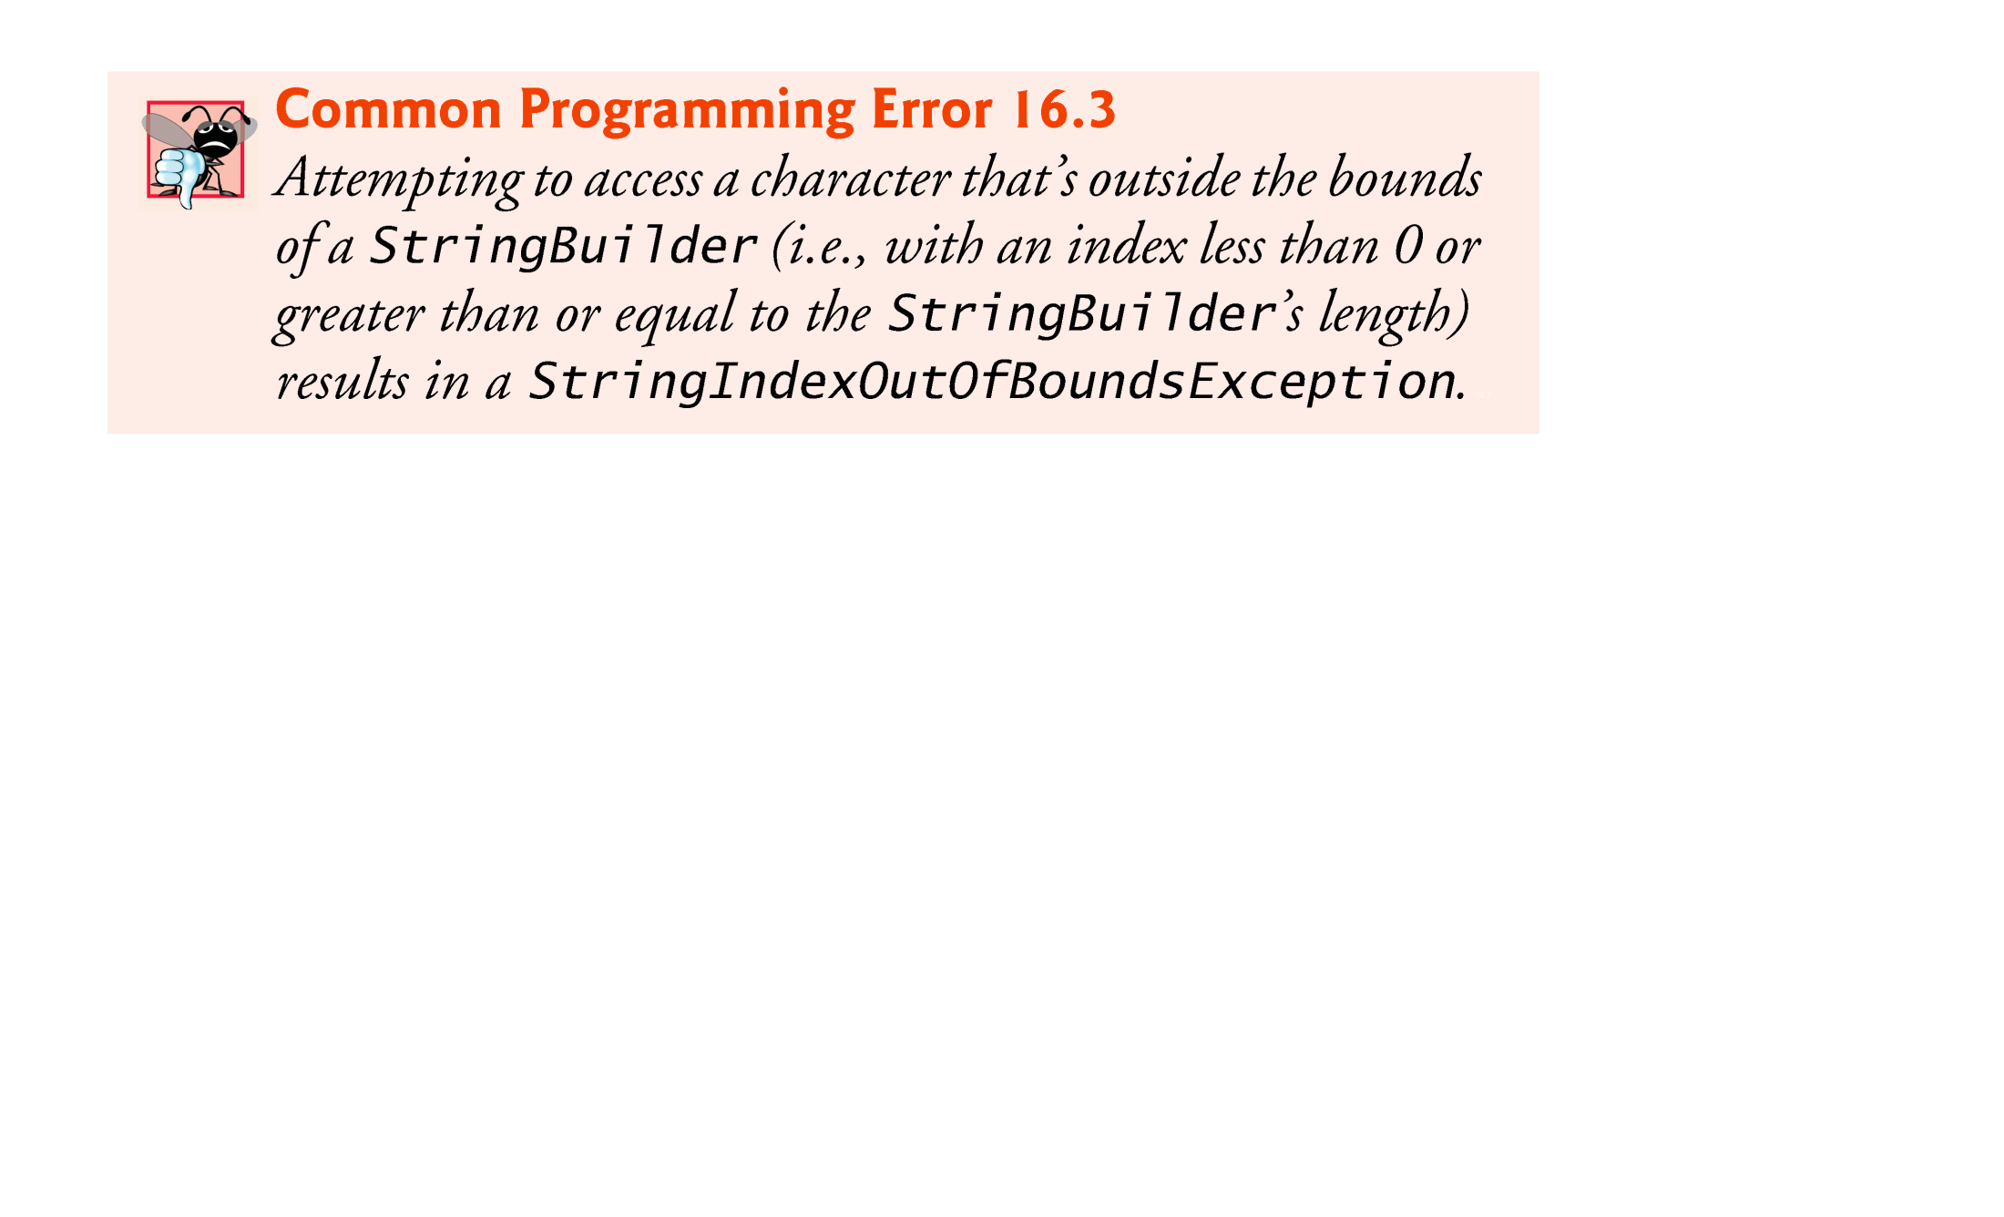

Slide 54
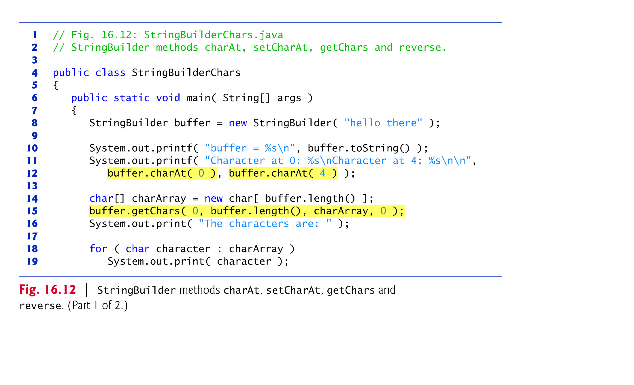

Slide 55
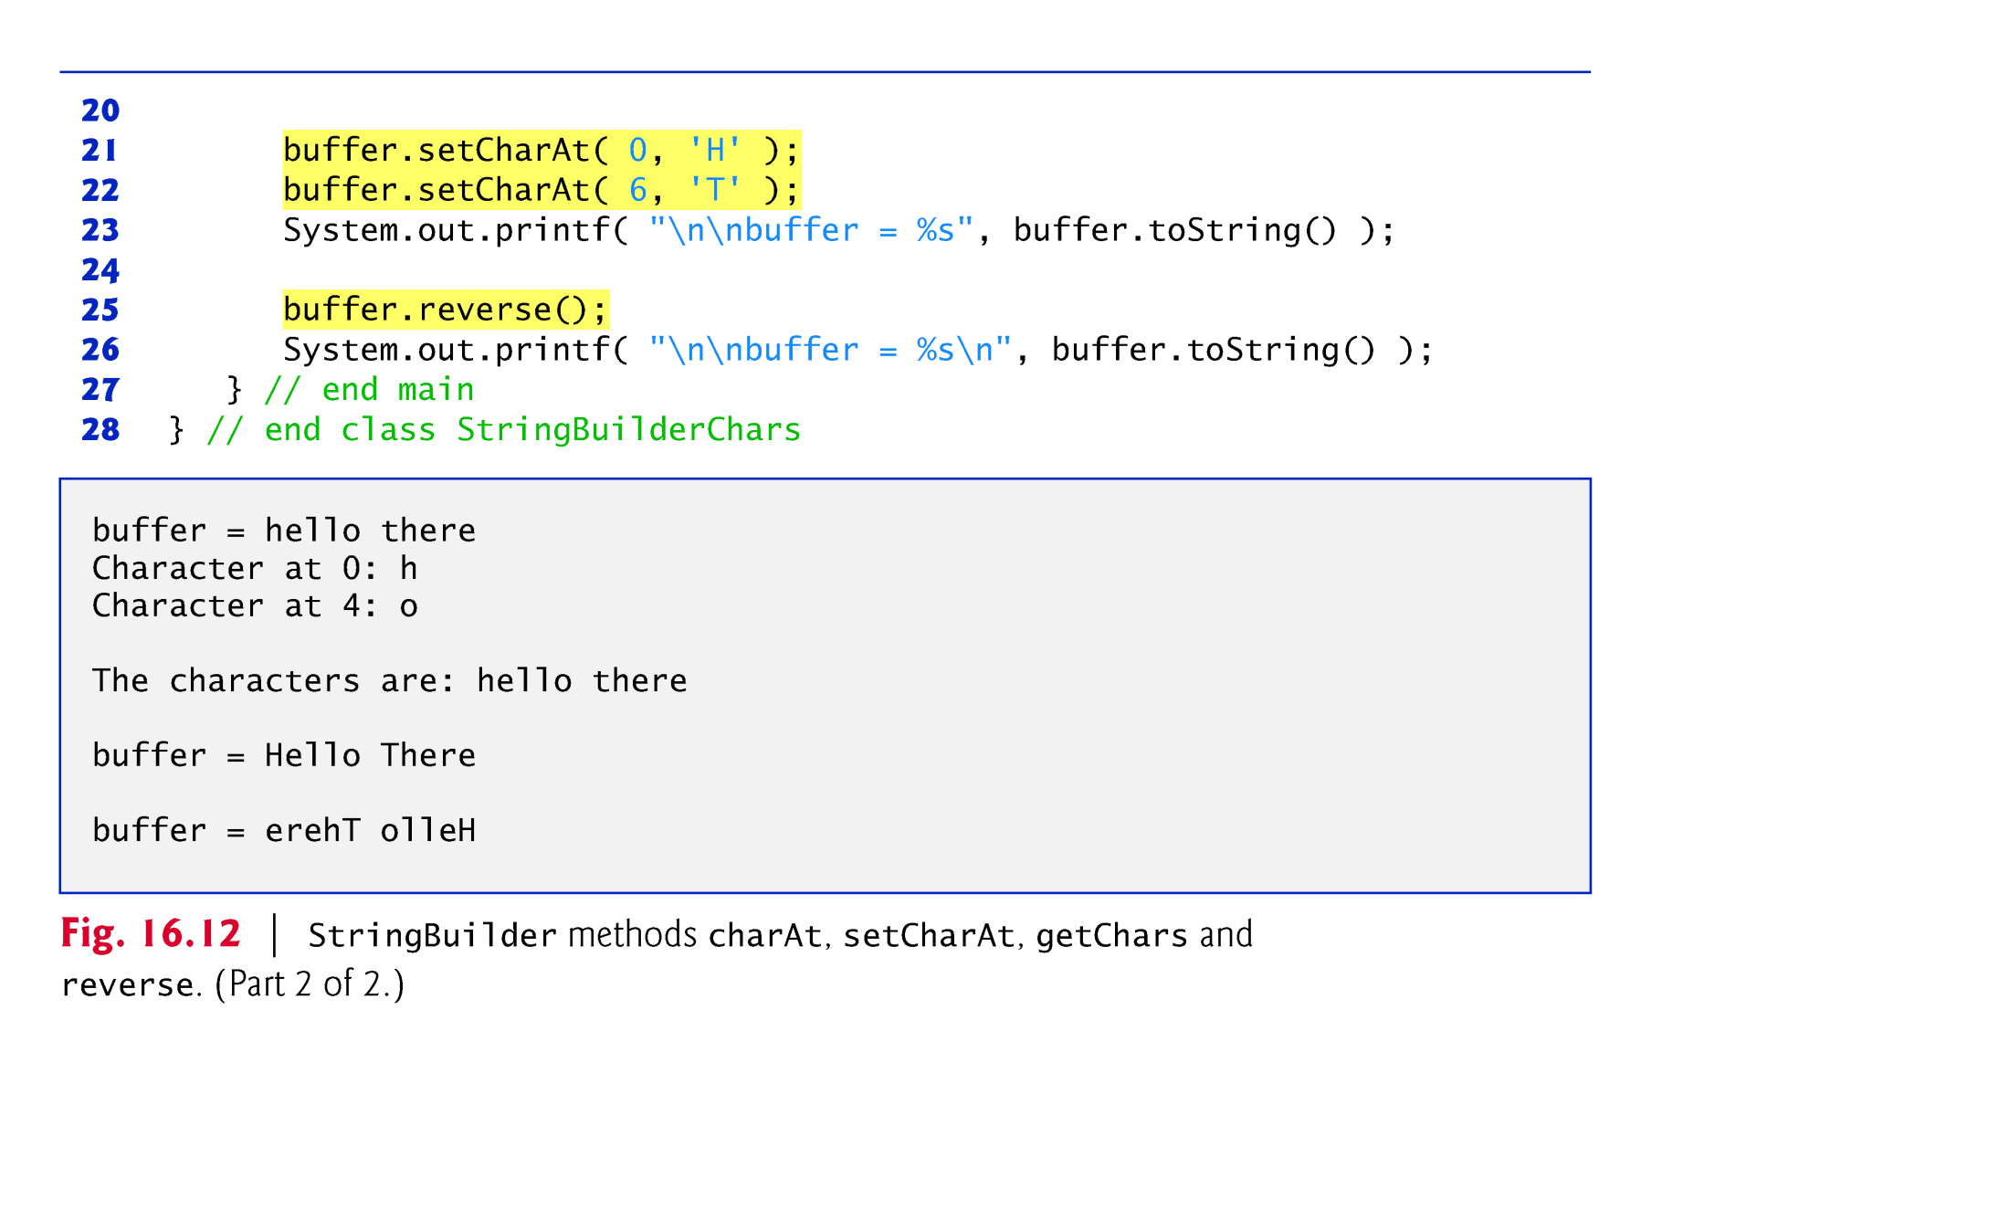

Slide 56
14.4.4 StringBuilder append Methods
Overloaded append methods allow values of various types to be appended to the end of a StringBuilder.
Versions are provided for each of the primitive types, and for character arrays, Strings, Objects, and more.

Slide 57
14.4.4 StringBuilder append Methods (cont.)
A compiler can use StringBuilder (or StringBuffer) and the append methods to implement the + and += String concatenation operators.

Slide 58
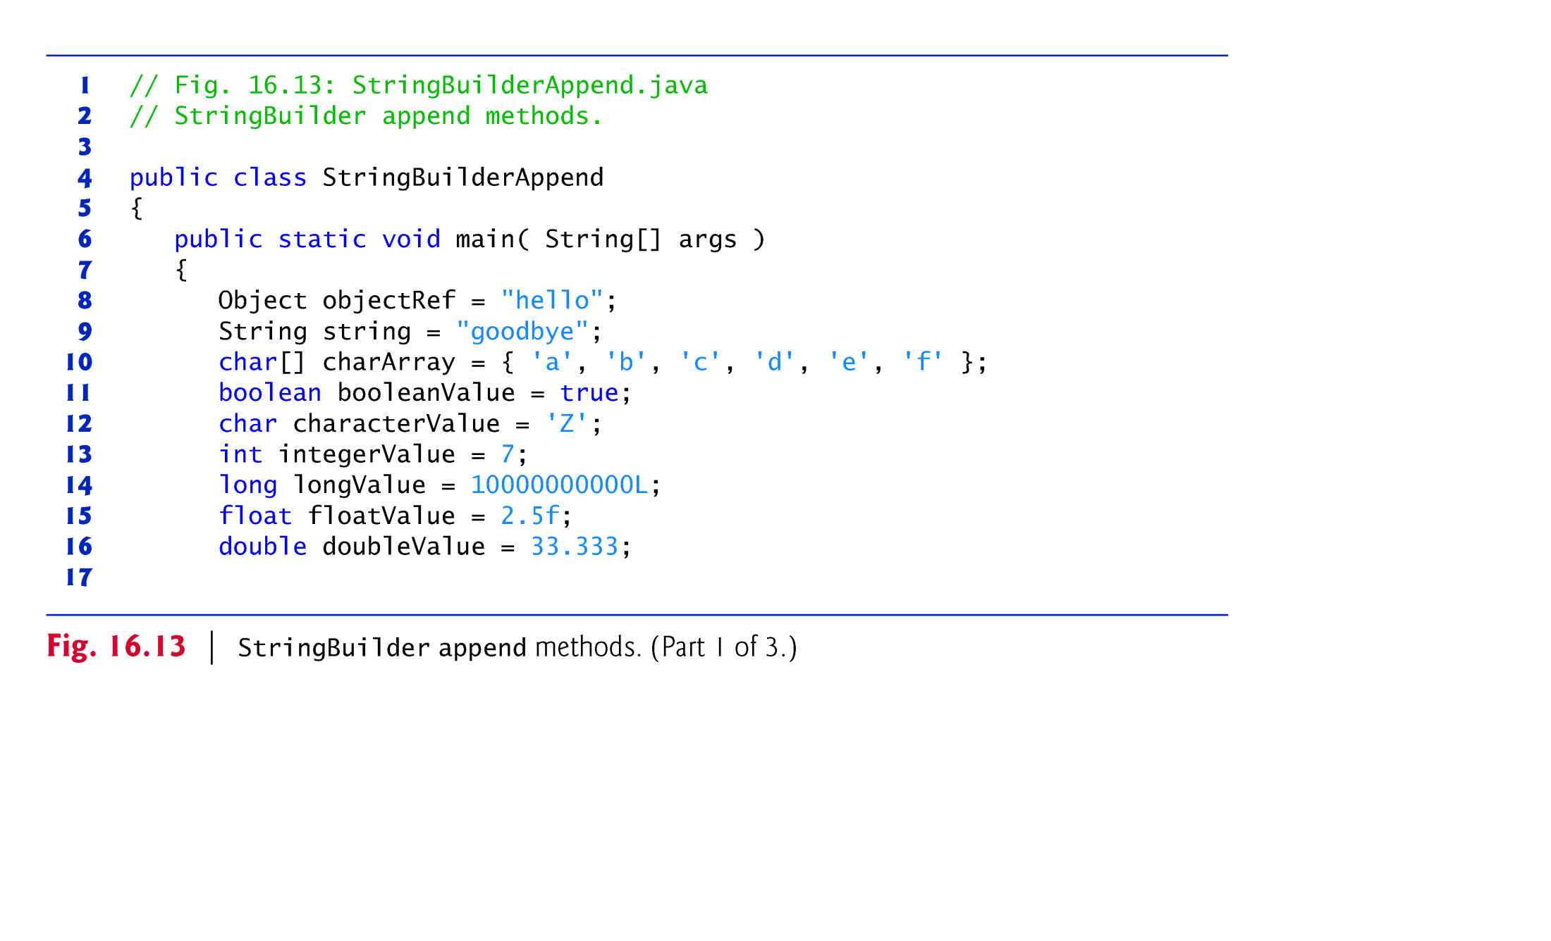

Slide 59
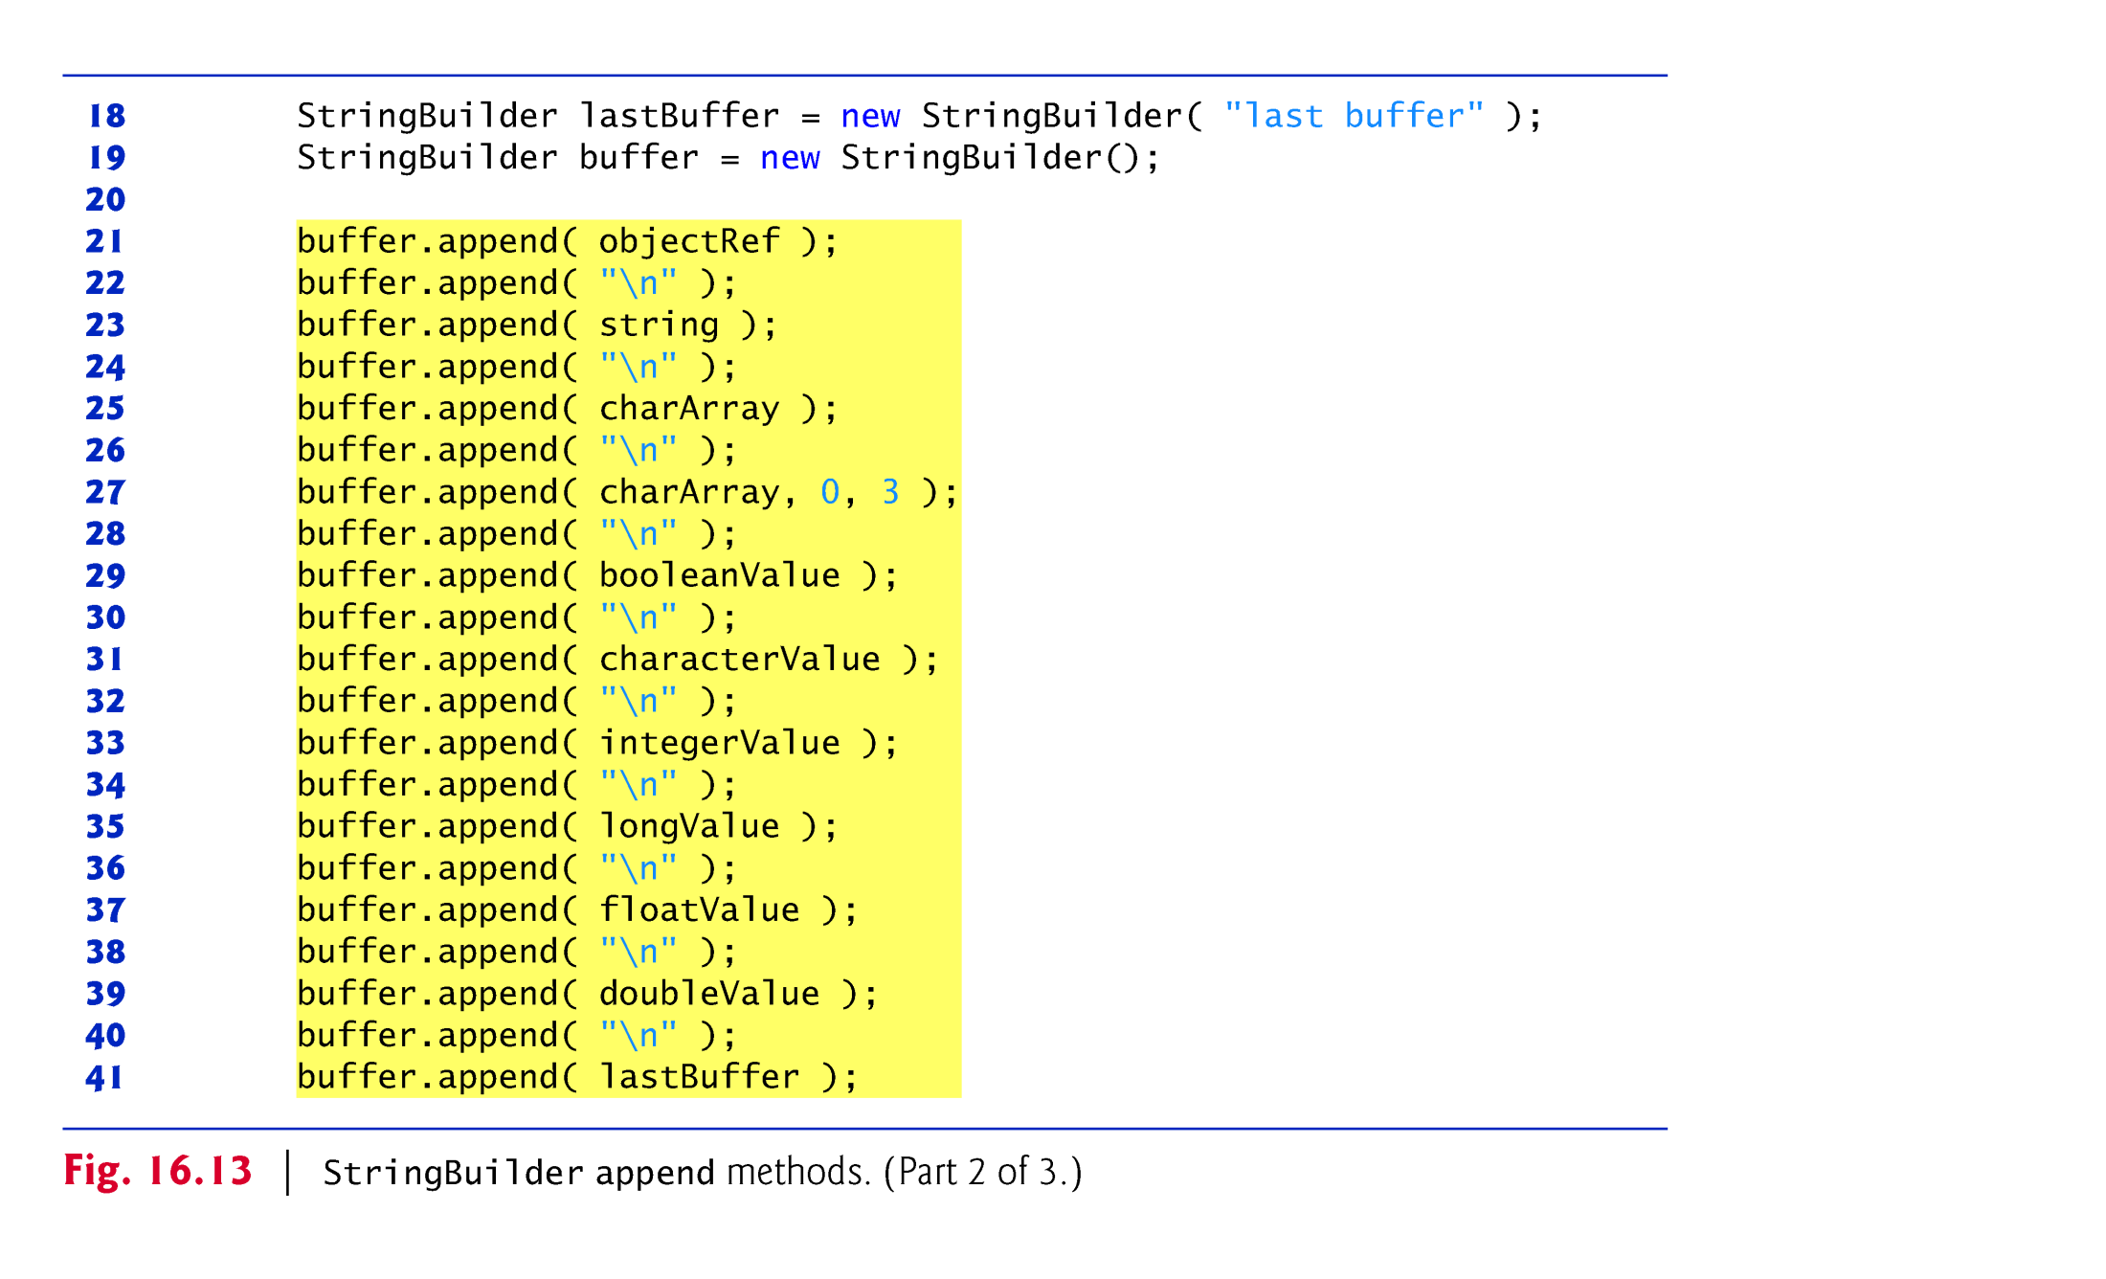

Slide 60
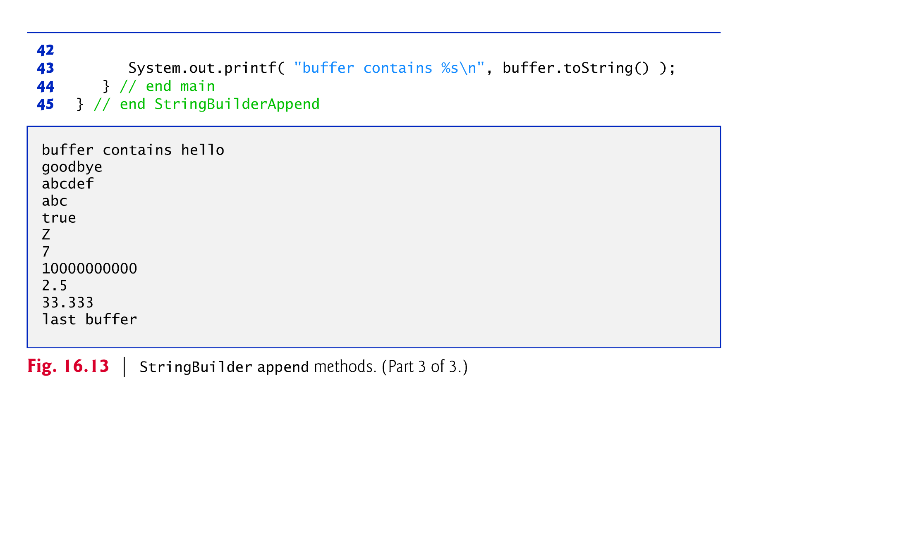

Slide 61
14.4.5 StringBuilder Insertion and Deletion Methods
Overloaded insert methods insert values of various types at any position in a StringBuilder.
Versions are provided for the primitive types and for character arrays, Strings, Objects and CharSequences.
Each method takes its second argument, converts it to a String and inserts it at the index specified by the first argument.
Methods delete and deleteCharAt delete characters at any position in a StringBuilder.
Method delete takes two arguments—the starting index and the index one past the end of the characters to delete.
Method deleteCharAt takes one argument—the index of the character to delete.

Slide 62
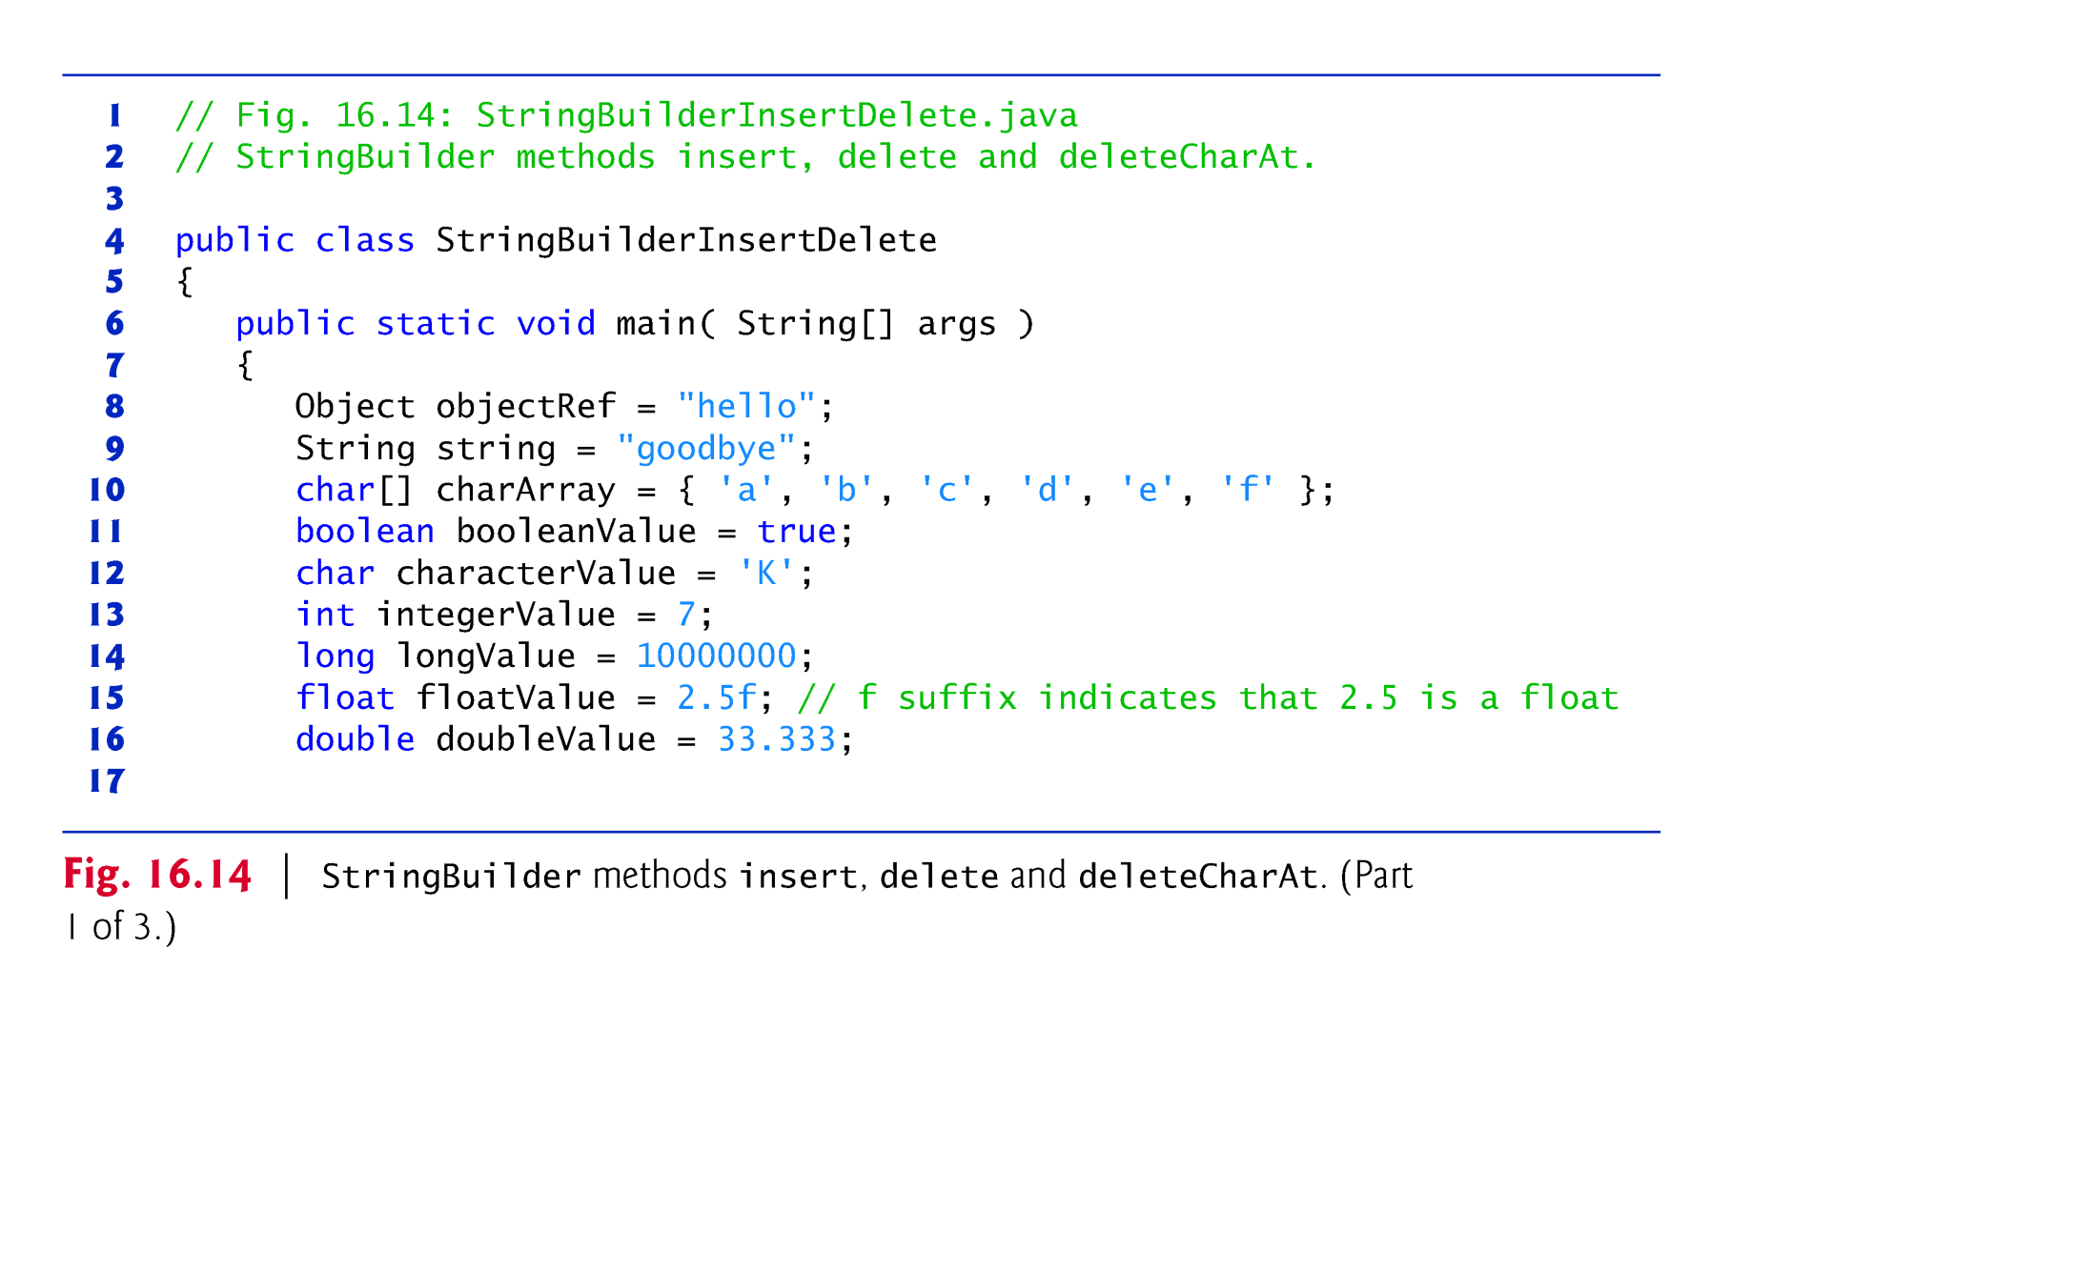

Slide 63
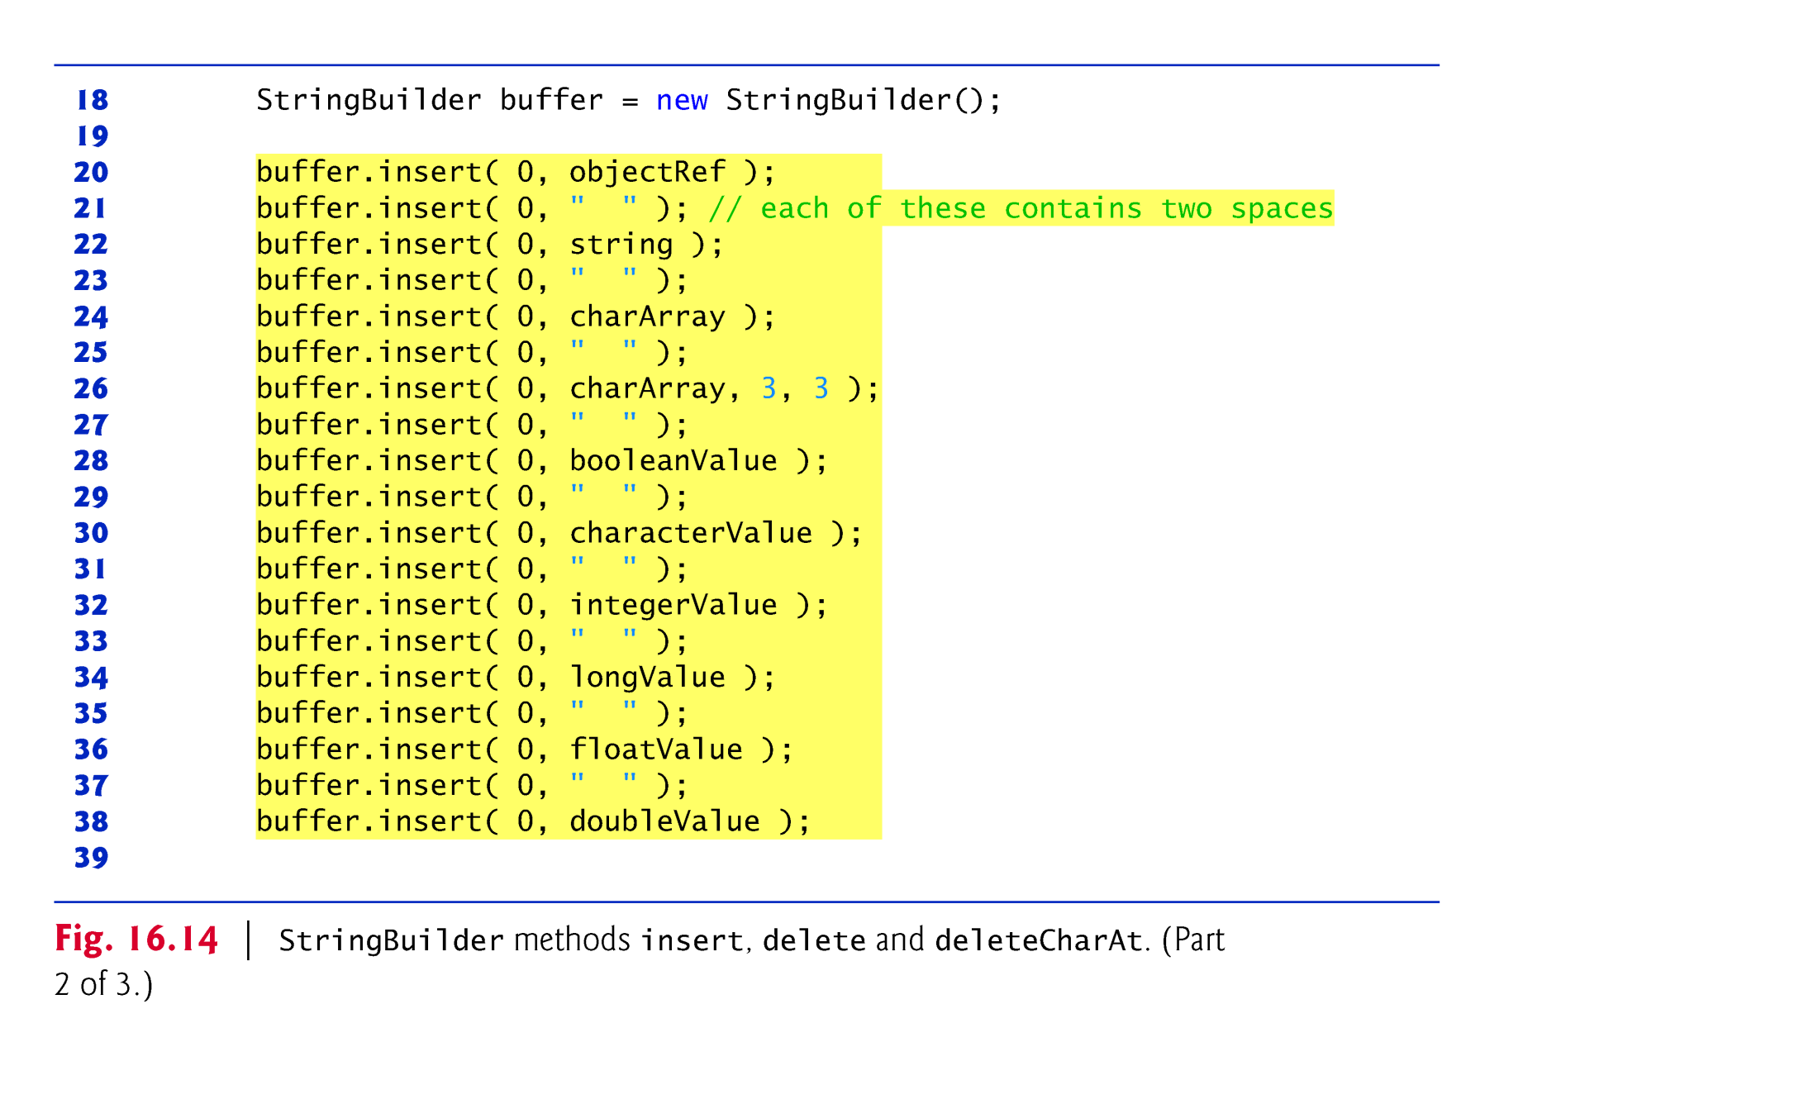

Slide 64
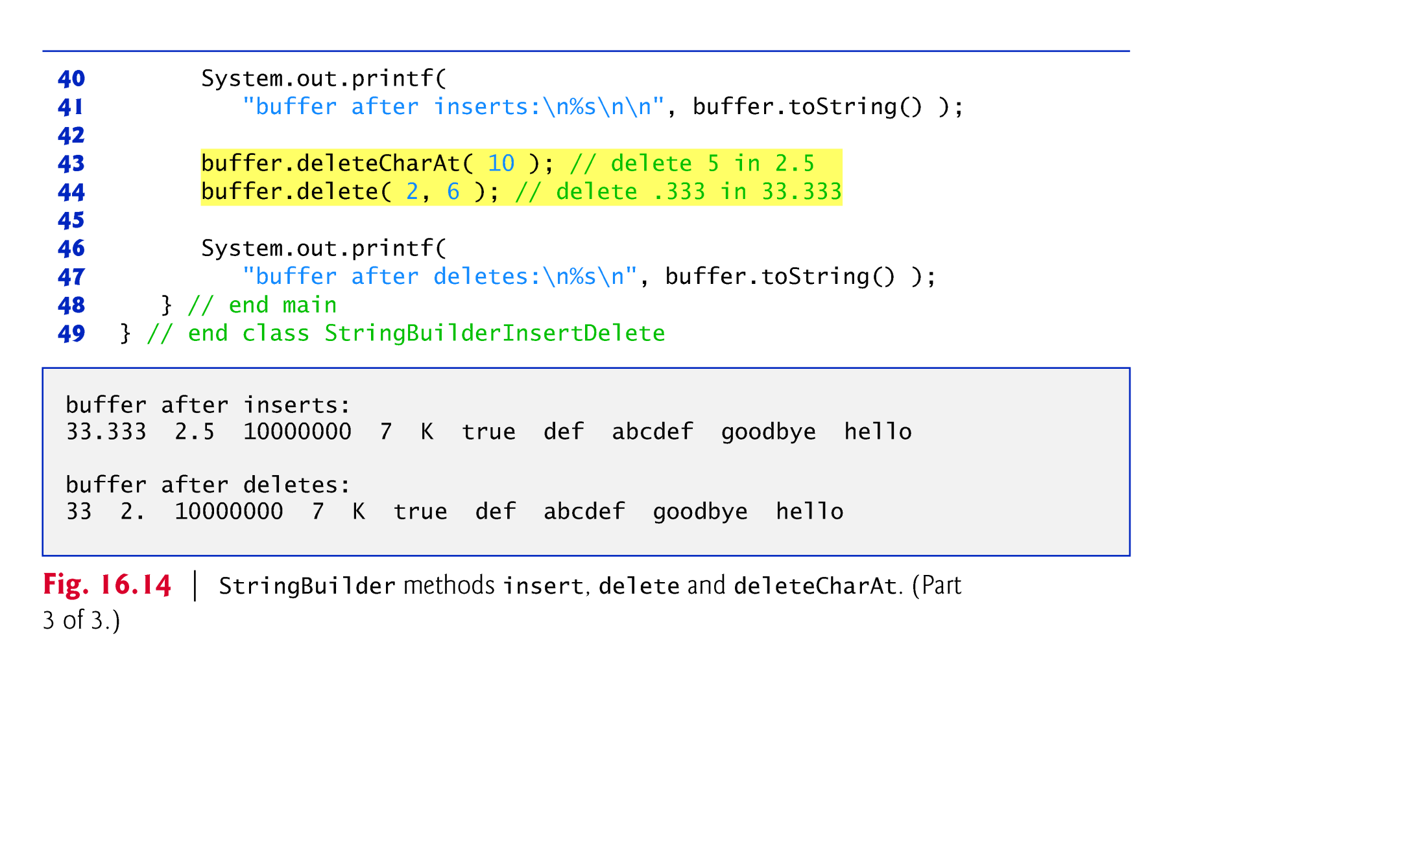

Slide 65
14.5 Class Character
Eight type-wrapper classes that enable primitive-type values to be treated as objects:
Boolean, Character, Double, Float, Byte, Short, Integer and Long
Most Character methods are static methods designed for convenience in processing individual char values.

Slide 66
14.5 Class Character (cont.)
Method isDefined determines whether a character is defined in the Unicode character set.
Method isDigit determines whether a character is a defined Unicode digit.
Method isJavaIdentifierStart determines whether a character can be the first character of an identifier in Java—that is, a letter, an underscore (_) or a dollar sign ($).
Method isJavaIdentifierPart determine whether a character can be used in an identifier in Java—that is, a digit, a letter, an underscore (_) or a dollar sign ($).

Slide 67
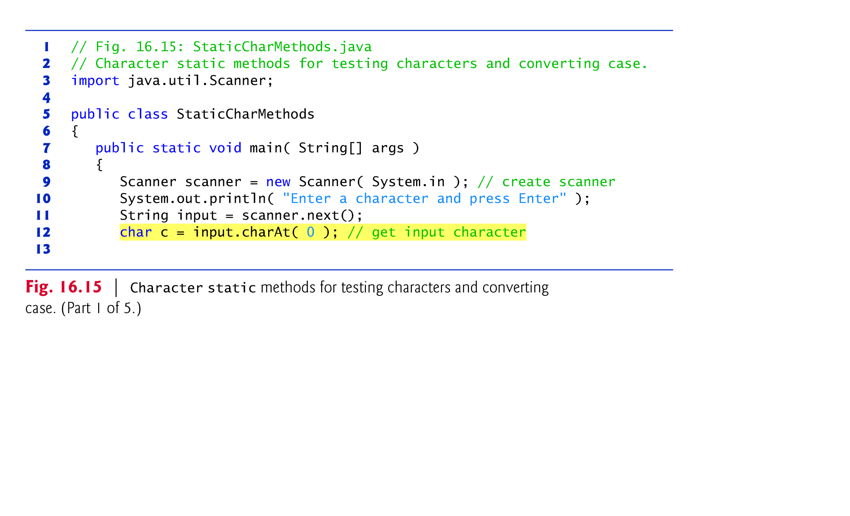

Slide 68
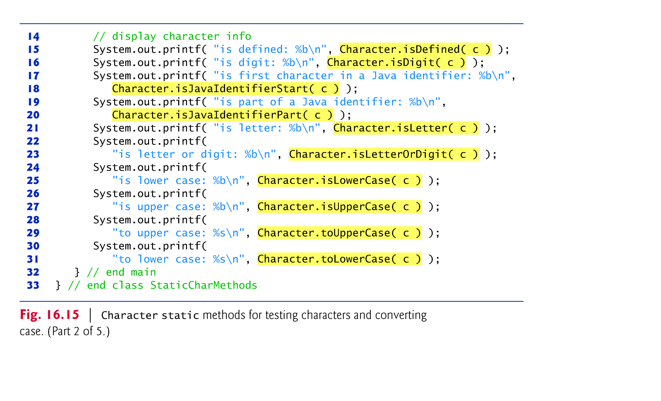

Slide 69
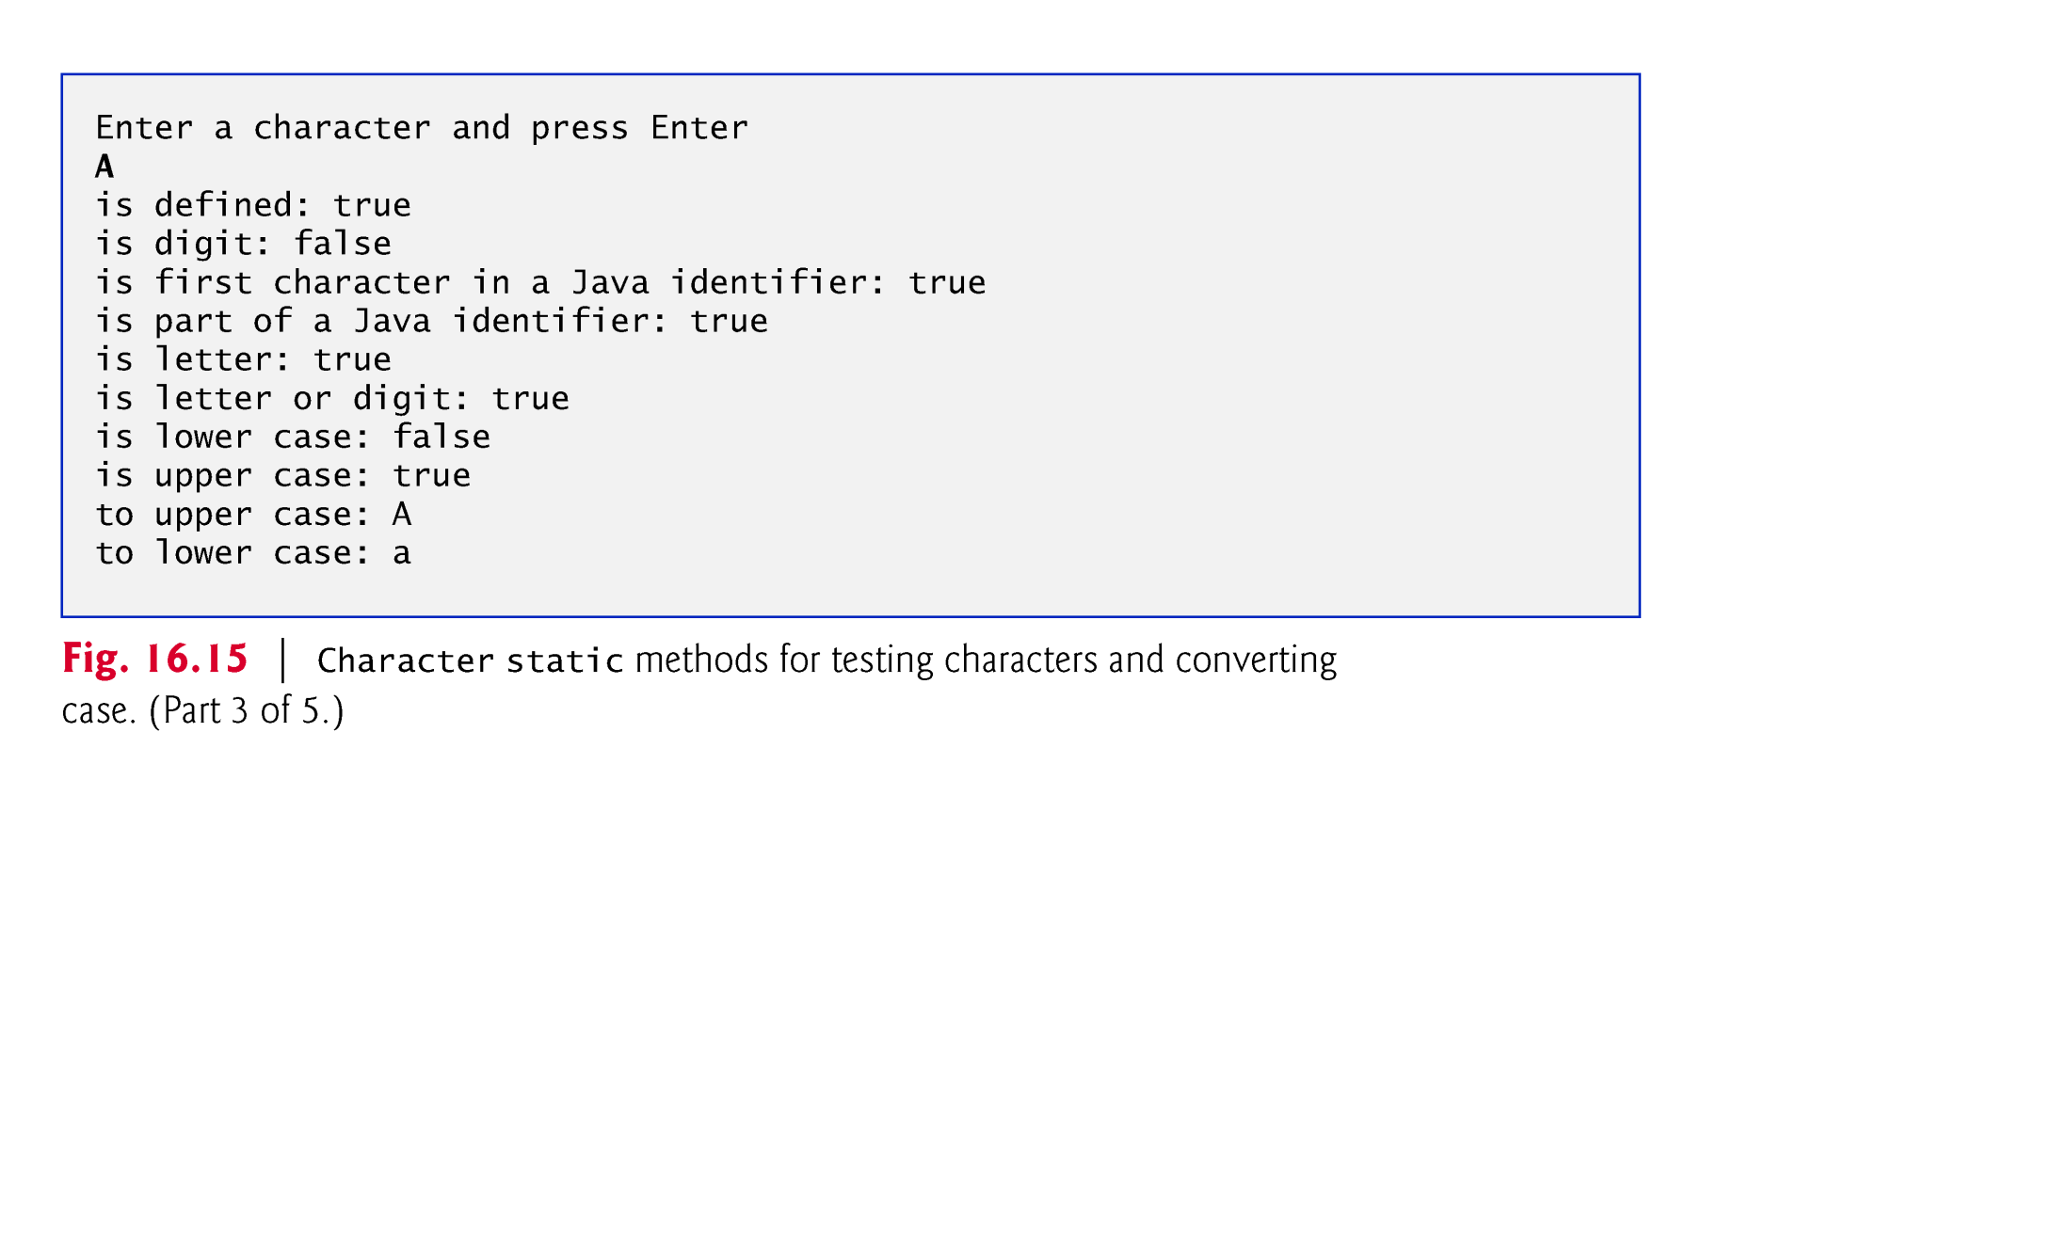

Slide 70


Slide 71


Slide 72
14.5 Class Character (cont.)
Method isLetter determines whether a character is a letter.
Method isLetterOrDigit determines whether a character is a letter or a digit.
Method isLowerCase determines whether a character is a lowercase letter.
Method isUpperCase determines whether a character is an uppercase letter.
Method toUpperCase converts a character to its uppercase equivalent.
Method toLowerCase converts a character to its lowercase equivalent.

Slide 73
14.5 Class Character (cont.)
Character method forDigit converts its first argument into a character in the number system specified by its second argument.
Character method digit converts its first argument into an integer in the number system specified by its second argument.
The radix (second argument) must be between 2 and 36, inclusive.

Slide 74
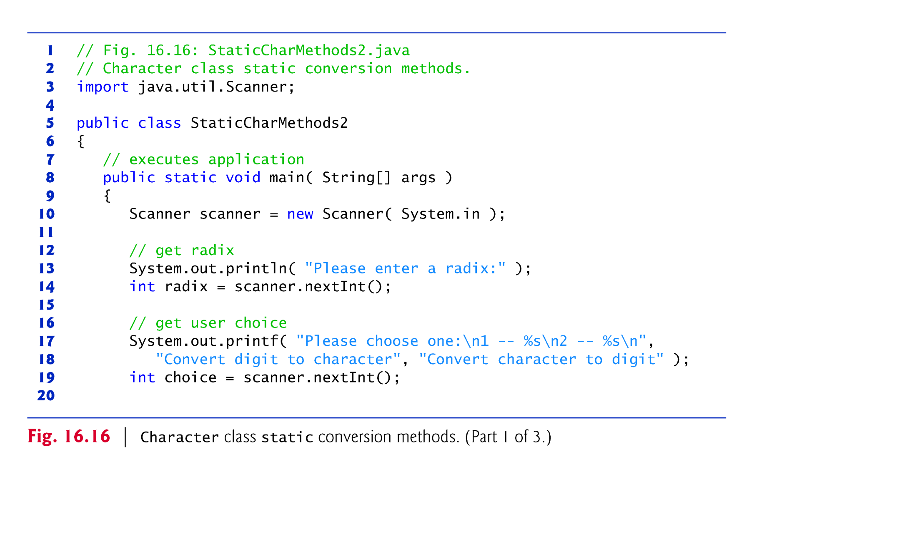

Slide 75
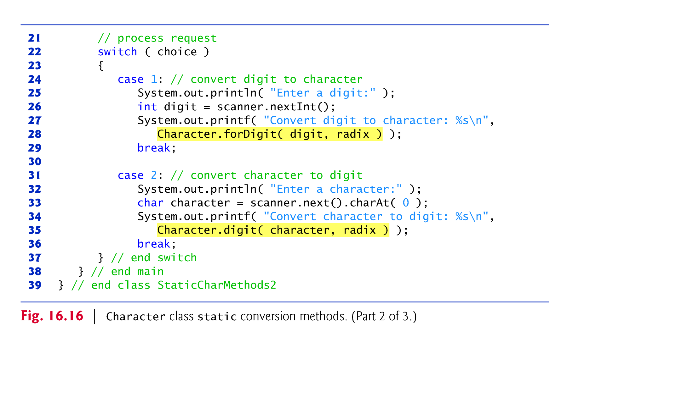

Slide 76
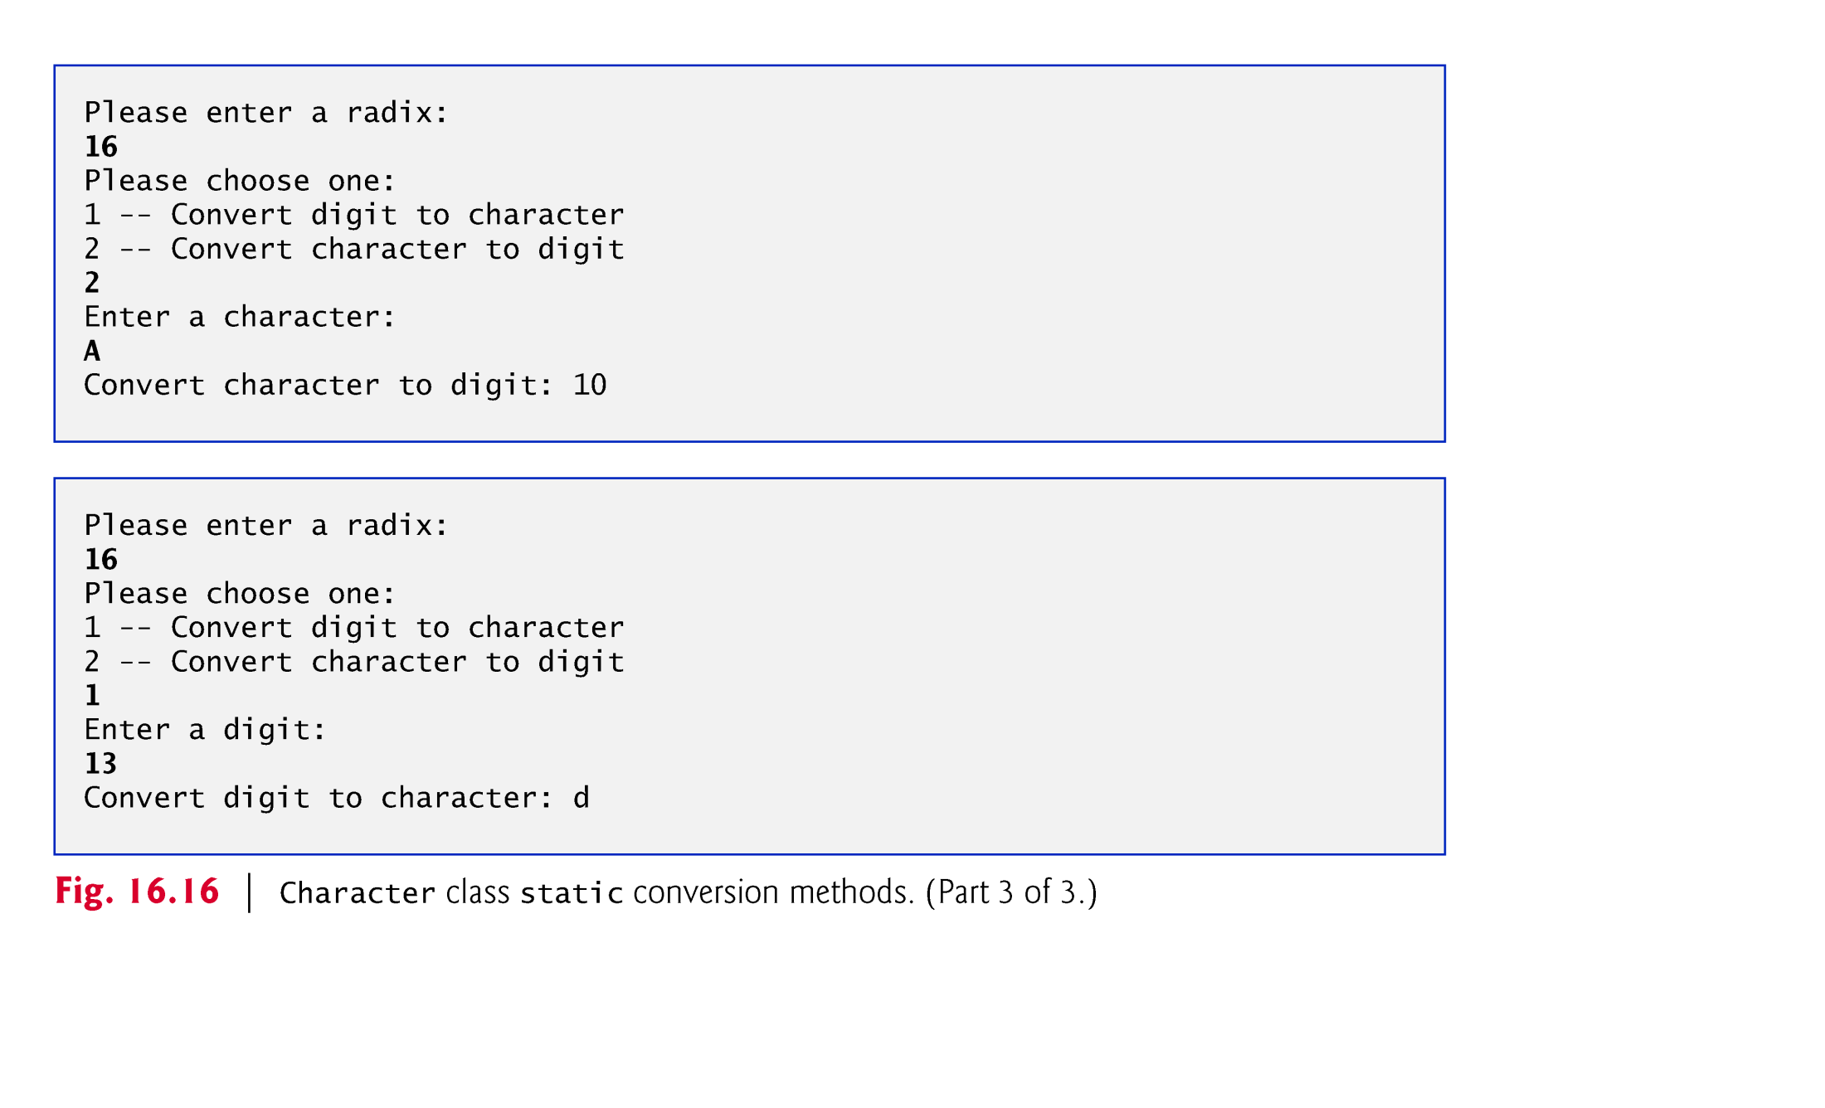

Slide 77
14.5 Class Character (cont.)
Java automatically converts char literals into Character objects when they are assigned to Character variables
Process known as autoboxing.
Method charValue returns the char value stored in the object.
Method toString returns the String representation of the char value stored in the object.
Method equals determines if two Characters have the same contents.

Slide 78


Slide 79
14.6 Tokenizing Strings
When you read a sentence, your mind breaks it into tokens(分组)—individual words and punctuation marks that convey meaning.
Compilers also perform tokenization.
String method split breaks a String into its component tokens and returns an array of Strings.
Tokens are separated by delimiters(定界符)
Typically white-space characters such as space, tab, newline and carriage return.
Other characters can also be used as delimiters to separate tokens.

Slide 80


Slide 81


Slide 82
14.7 Regular Expressions, Class Pattern and Class Matcher
A regular expression is a specially formatted String that describes a search pattern for matching characters in other Strings.
Useful for validating input and ensuring that data is in a particular format.
One application of regular expressions is to facilitate the construction of a compiler.
Often, a large and complex regular expression is used to validate the syntax of a program.
If the program code does not match the regular expression, the compiler knows that there is a syntax error within the code.

Slide 83
14.7 Regular Expressions, Class Pattern and Class Matcher (cont.)
String method matches receives a String that specifies the regular expression and matches the contents of the String object on which it’s called to the regular expression.
The method returns a boolean indicating whether the match succeeded.
A regular expression consists of literal characters and special symbols.

Slide 84
14.7 Regular Expressions, Class Pattern and Class Matcher (cont.)
To match a set of characters that does not have a predefined character class, use square brackets, [].
The pattern "[aeiou]" matches a single character that’s a vowel.
Character ranges are represented by placing a dash (-) between two characters.
"[A-Z]" matches a single uppercase letter.
If the first character in the brackets is "^", the expression accepts any character other than those indicated.
"[^Z]" is not the same as "[A-Y]", which matches uppercase letters A–Y—"[^Z]" matches any character other than capital Z, including lowercase letters and nonletters such as the newline character.

Slide 85


Slide 86


Slide 87


Slide 88


Slide 89


Slide 90


Slide 91


Slide 92


Slide 93
14.7 Regular Expressions, Class Pattern and Class Matcher (cont.)
Sometimes it’s useful to replace parts of a string or to split a string into pieces. For this purpose, class String provides methods replaceAll, replaceFirst and split.

Slide 94
14.7 Regular Expressions, Class Pattern and Class Matcher (cont.)
String method replaceAll replaces text in a String with new text (the second argument) wherever the original String matches a regular expression (the first argument).
Escaping a special regular-expression character with \ instructs the matching engine to find the actual character.
String method replaceFirst replaces the first occurrence of a pattern match.

Slide 95


Slide 96


Slide 97


Slide 98
14.7 Regular Expressions, Class Pattern and Class Matcher (cont.)
Class Pattern represents a regular expression.
Class Matcher contains both a regular-expression pattern and a CharSequence in which to search for the pattern.

Slide 99
14.7 Regular Expressions, Class Pattern and Class Matcher (cont.)
If a regular expression will be used only once, static Pattern method matches can be used.
Takes a String that specifies the regular expression and a CharSequence on which to perform the match.
Returns a boolean indicating whether the search object (the second argument) matches the regular expression.

Slide 100


Slide 101


Slide 102


Slide 103
14.7 Regular Expressions, Class Pattern and Class Matcher (cont.)
The dot character "." in a regular expression matches any single character except a newline character.
Matcher method find attempts to match a piece of the search object to the search pattern.
Each call to this method starts at the point where the last call ended, so multiple matches can be found.
Matcher method lookingAt performs the same way, except that it always starts from the beginning of the search object and will always find the first match if there is one.

Slide 104


Slide 105
14.7 Regular Expressions, Class Pattern and Class Matcher (cont.)
Matcher method group returns the String from the search object that matches the search pattern.
The String that is returned is the one that was last matched by a call to find or lookingAt.
For more information on regular expressions, visit our Regular Expressions Resource Center at www.deitel.com/regularexpressions/.

Slide 106
14.7 Regular Expressions, Class Pattern and Class Matcher (cont.)
Java SE 8
you can combine regular expression processing with Java SE 8 lambdas and streams to implement powerful String- and file processing applications.（ see in Section 17.13 ）

Slide 107
14.7 Regular Expressions, Class Pattern and Class Matcher (cont.)
Java SE 9: New Matcher Methods
Java SE 9 adds several new Matcher method overloads appendReplacement, appendTail, replaceAll, results and replaceFirst.
Methods appendReplacement and appendTail simply receive StringBuilders rather than StringBuffers.
Methods replaceAll, results and replaceFirst are meant for use with lambdas and streams. We’ll show these three methods in Chapter 17.

Slide 108

// NewMatcherTest.java
package ch14;
import java.util.regex.Matcher;
import java.util.regex.Pattern;
public class NewMatcherTest {
public static void main(String[] args) {
Pattern p = Pattern.compile("cat");
Matcher m = p.matcher("one cat two cats in the yard");
StringBuilder sb = new StringBuilder();
while (m.find()) {
m.appendReplacement(sb, "dog");
}
m.appendTail(sb);
System.out.println(sb.toString());
}
}

